Slide 1
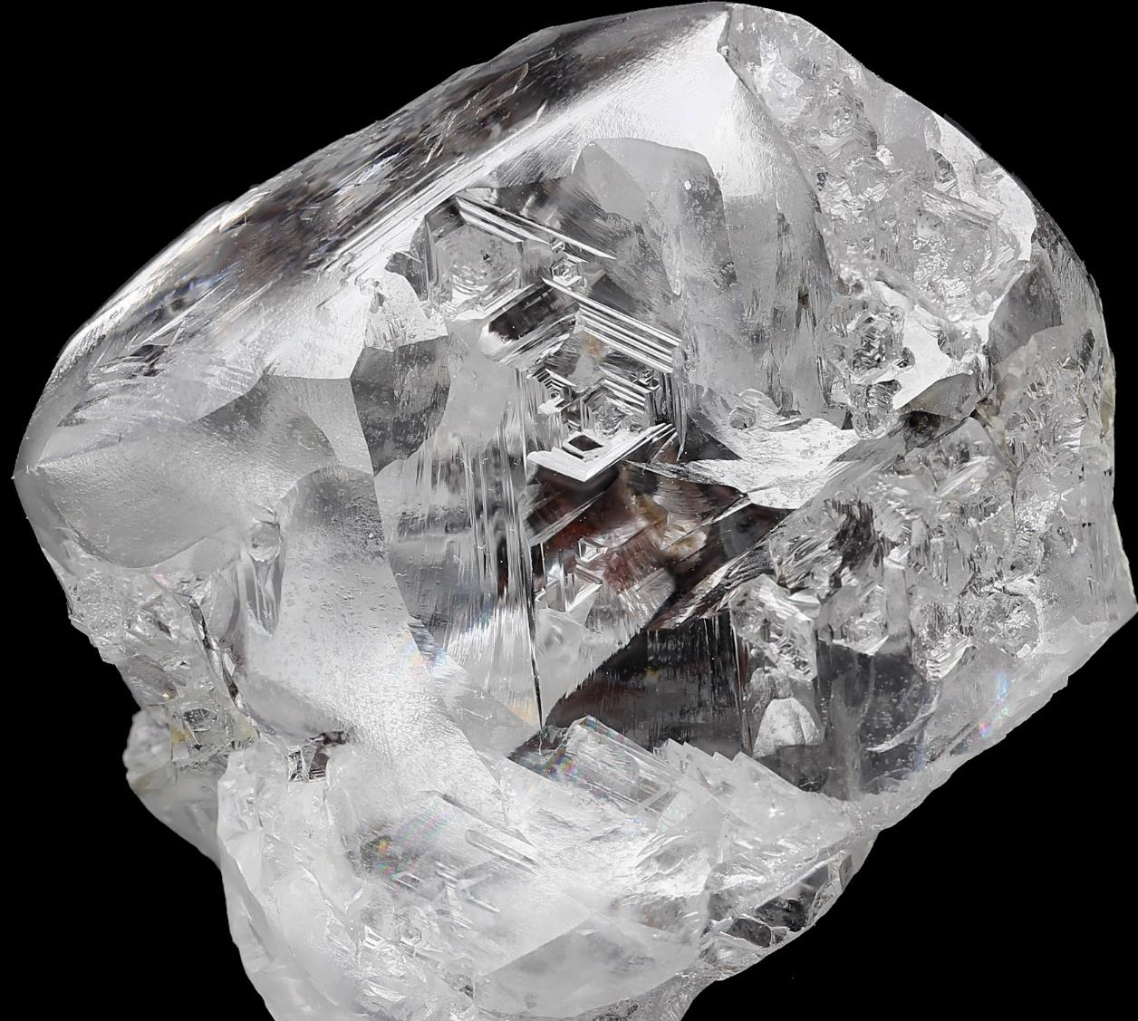


Lucapa Diamond Company Limited
ASX: LOM
A
PRODUCER
& EXPLORER
of large high-value diamonds
Corporate Presentation
31 March 2021

Slide 2


Cautionary Statements
Forward-Looking Statements
This Presentation has been prepared by Lucapa Diamond Company Limited (“the Company”). This document contains background information about the Company current at the date of this Presentation. The Presentation is in summary form and does not purport to be all inclusive or complete. Recipients should conduct their own investigations and perform their own analysis in order to satisfy themselves as to the accuracy and completeness of the information, statements and opinions contained in this Presentation. This Presentation is for information purposes only. Neither this Presentation nor the information contained in it constitutes an offer, invitation, solicitation or recommendation in relation to the purchase or sale of shares in any jurisdiction. This Presentation may not be distributed in any jurisdiction except in accordance with the legal requirements applicable in such jurisdiction. Recipients should inform themselves of the restrictions that apply in their own jurisdiction. A failure to do so may result in a violation of securities laws in such jurisdiction. This Presentation does not constitute investment advice and has been prepared without taking into account the recipient’s investment objectives, financial circumstances or particular needs and the opinions and recommendations in this representation are not intended to represent recommendations of particular investments to particular persons. Recipients should seek professional advice when deciding if an investment is appropriate. All securities transactions involve risks, which include (among others) the risk of adverse or unanticipated market, financial or political developments.
To the fullest extent permitted by law, the Company, its officers, employees, agents and advisers do not make any representation or warranty, express or implied, as to the currency, accuracy, reliability or completeness of any information, statements, opinion, estimates, forecasts or other representations contained in this Presentation. No responsibility for any errors or omissions from this Presentation arising out of negligence or otherwise is accepted. This Presentation may include forward-looking statements. Forward-looking statements are only predictions and are subject to risks, uncertainties and assumptions which are outside the control of the Company. Actual values, results or events may be materially different to those express or implied in this Presentation. Given these uncertainties, recipients are cautioned not to place reliance on forward-looking statements. Any forward-looking statements in this Presentation speak only at the date of issue of this Presentation. Subject to any continuing obligations under applicable law and ASX Listing Rules, the Company does not undertake any obligation to update or revise any information or any of the forward-looking statements in this Presentation or any changes in events, conditions or circumstances on which any such forward-looking statement is based.
No New Information
To the extent that this presentation contains references to prior exploration results and Mineral Resource estimates, which have been cross referenced to previous market announcements made by the Company, unless explicitly stated, no new information is contained. The Company confirms that it is not aware of any new information or data that materially affects the information included in the relevant market announcements and, in the case of estimates of Mineral Resources that all material assumptions and technical parameters underpinning the estimates in the relevant market announcement continue to apply.
Competent Person’s Statements
Information included in this presentation that relates to exploration results and resource estimates on the Lulo Diamond Resource and Mothae Diamond Resource is based on and fairly represents information and supporting documentation prepared and compiled by Richard Price who is a Member of the Australasian Institute of Mining and Metallurgy. Mr Price is an employee of the Company. Mr Price has sufficient experience which is relevant to the style of mineralisation and type of deposits under consideration and to the activity which he is undertaking to qualify as a Competent Person as defined in the 2012 Edition of the Australasian Code for Reporting Exploration Results, Mineral Resources and Ore Reserves. Mr Price consents to the inclusion in the presentation of the matters based on this information in the form and context in which it appears.

Slide 3




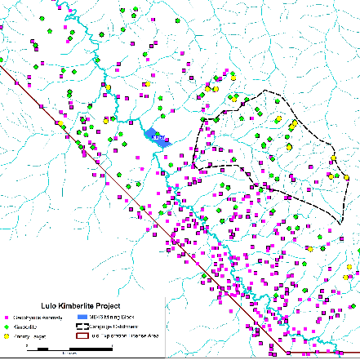


Lucapa’s Journey
Successful developer of diamond projects
Growing Australian diamond company
  Listed on the
Transformed significantly
  -> 2014 - Explorer (single country)
  2014 - 2019 – Investment in production & transformed into a multi-asset producer & explorer (four countries)
    Two niche high-quality producing mines
    Three primary source exploration assets
  2020 – a very tough year – pandemic shuttered operations BUT we maintained our focus
    Resource expansion
    Capacity expansion
  2021 – cash flow generation
ASSETS
Development
Exploration/ Evaluation
Development/ Funding
Production/ Expansion
Cutting & Polishing
Producing mines
Lulo
Secondary
(alluvial)
Angola
Mothae
Primary
(kimberlite)
Lesotho
Exploration projects
Lulo JV
Primary
(kimberlite)
Advanced
Angola
Brooking
Primary
(lamproite)
Early
Australia
Orapa
Primary
(kimberlite)
Early
Botswana

Slide 4
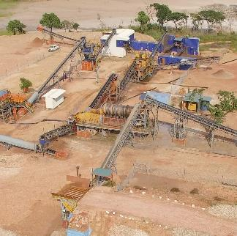
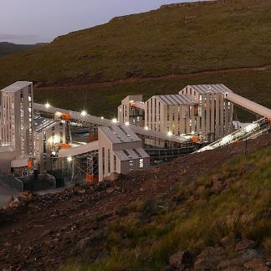
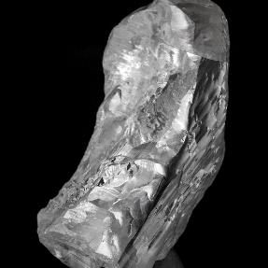
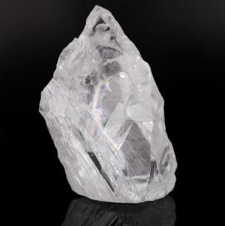
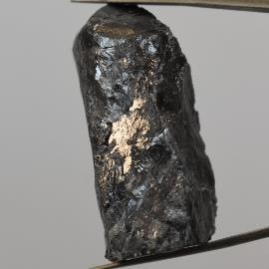
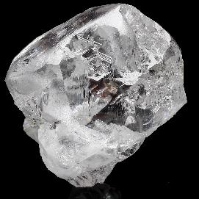
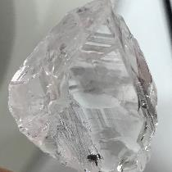
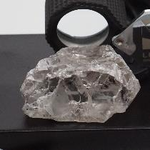
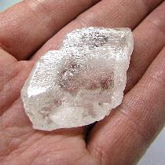
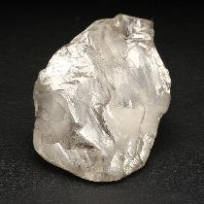
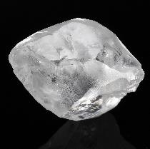
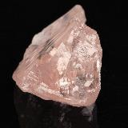
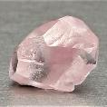
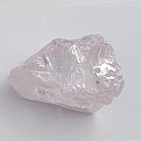
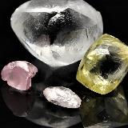
Major Assets - Mines
Developed and built two niche producing mines…
Large high-quality diamond productions
Lulo mine
(40%)
Mothae mine
(70%)
404 carat
227 carat
220 carat
213 carat
0.5 million bulk cubic metres (“Mbcm”) per annum
Highest price alluvial mine
2021 to date
  Impact of expanded fleet being felt
  6 +100 carat carat recovery + 2 pinks
  Record revenues
  Record prices
1.6 million tonne (“Mt”) per annum
2nd highest price kimberlite mine
2021 to date
  45% expansion delivered
  213 carat recovery
  Record revenues
  Record prices
173 carat
171 carat
131 carat
126 carat
101 carat
Cutting & polishing margins on top
Source: 2019 Zimnisky/ published data/ (A) = alluvial/ (K) = kimberlite

Slide 5
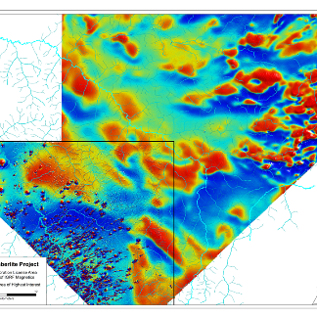
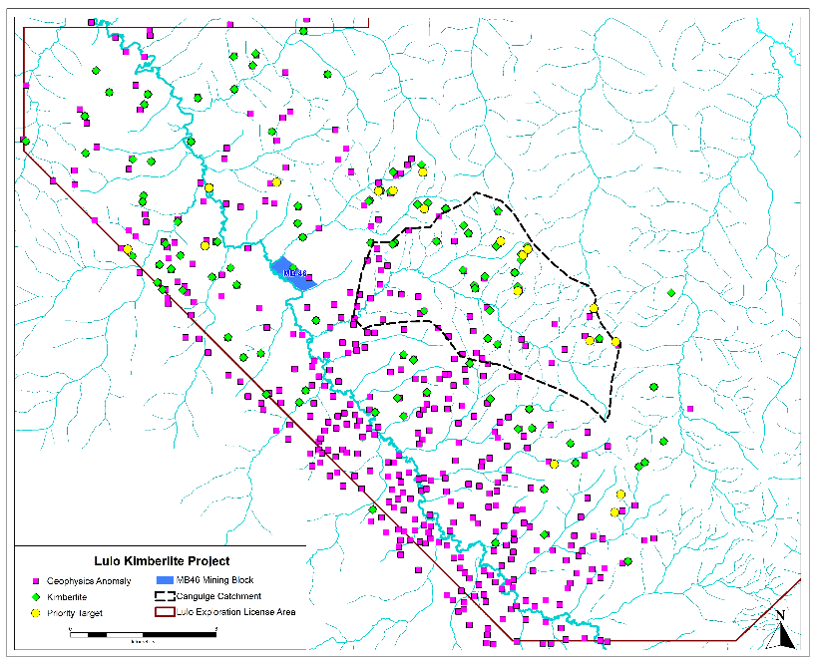
Major Asset – Exploration
…advanced Lulo kimberlite exploration project
…One of the most prospective
diamond exploration projects
in our space…
Significant programs of work completed
Airborne & ground geophysics/ multiple drilling campaigns/ mineral chemistry analysis/ sampling/ peer reviews:
    >500 anomalies/ targets
    >100 kimberlites confirmed
    Selected 18 high-priority kimberlites
Priority targets in Canguige catchment area focus post Canguige river sampling results
    Subsequent mining in MB46 increasing significance
    Six +100 carat diamonds recovered there in last 3 months
    Two Special sized pink diamonds
Currently in bulk sampling phase - testing high-priority kimberlites for diamond content
Majority stake discussions advancing, and success will see significant impetus to program/ results
Lulo JV exploration
(39%)
SML mine
Canguige Catchment
Large stone environment - >1,300 Specials & 22 +100 carat stones
Very high-quality diamonds
Irregular shaped/ jagged edges/ not travelled far
Significant kimberlite province
Province confirmed as diamondiferous
MB46

Slide 6
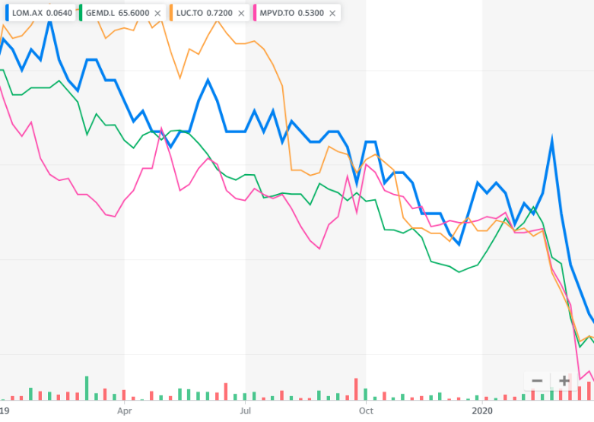
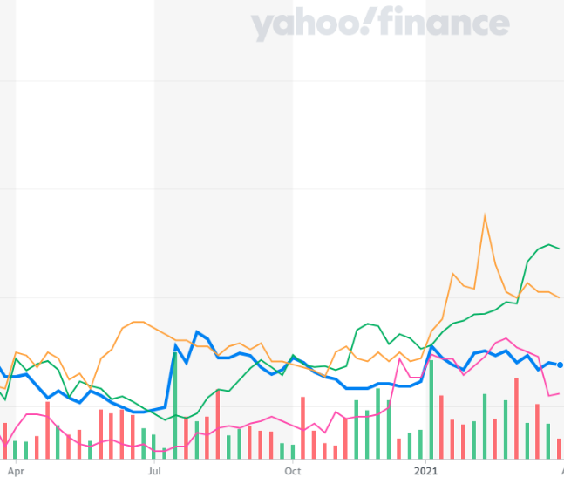
Diamond Market
Listed diamond equities…lagging diamond market recovery
Share prices of listed diamond equities indexed to 1 Jan 2019
Diamond prices bounced back to Jan 2019 levels (higher than pre-pandemic)
Listed equites yet to reflect this recovery
Overall rough diamond price index depicted
High-quality diamonds recovered faster than commercial quality
Source: GTD Consulting/ Yahoo Finance

Slide 7
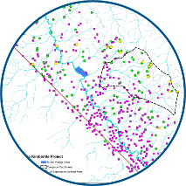

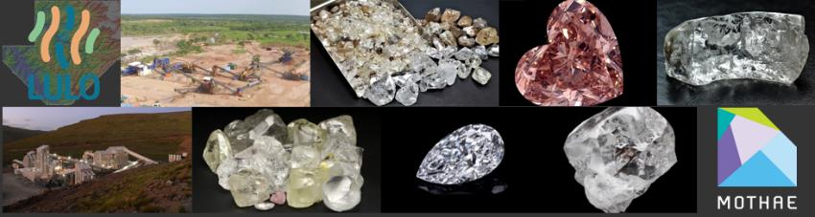

2021 – Cash flow generation
…production assets delivered and diamond market strong
Diamond Production
Diamond Exploration
Both mines operating at expanded capacities
What to expect for rest of 2021? More records -
Recommencing bulk sampling program following wet season
Majority stake discussions advancing
Volume
Production
Large stone frequency
Price
Rough revenues
Polished revenues
We are just 3 months in and….
2021 is already a defining year for Lucapa!
Reduced per unit operating costs
Profits
Cash flows
Returns on mining investments to Lucapa
Not from one, but two niche mining operations
Maiden production guidance for 2021 to be published Q2

Slide 8



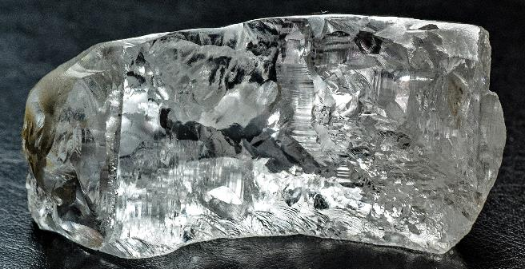
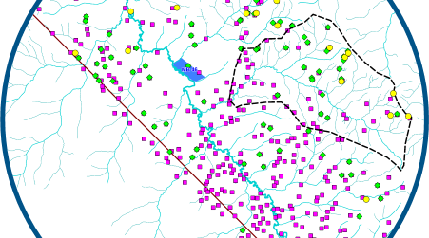
34 Bagot Road
Subiaco 6008
Western Australia
Tel: +61 8 9381 5995
Email: general@lucapa.com.au
Website: www.lucapa.com.au

