Slide 1

The next generation of nature.
The Next Generation
of Nature is FutureGrown™
Chris Savile, PhD, President & CEO
Emerging Growth Conference
June 14th, 2023
January 2023
TSX: WLLW
willowbio.com
OTCQB: CANSF

Slide 2
DISCLAIMER
Certain information included in this presentation constitutes forward-looking information under applicable securities legislation. Forward looking information typically contains statements with words such as "will", “may,” "anticipate", "believe", "expect", "plan", "intend", "estimate", "propose," “could,” “potential,” “positioned for,” “becoming,” “likely,” or similar words suggesting future outcomes or statements regarding an outlook. Forward-looking information in this presentation includes, but is not limited to, statements relating to: the business, strategies, expectations, planned operations and future actions of Willow Biosciences Inc. ("Willow" or the "Company"), including research and development programs at the facility located in California; the Company's ability to commercially biosynthesize and create proprietary genomes; the Company’s milestone projections, including the timing of commercialization of the various products in its portfolio; the sustainability of traditional manufacturing processes and benefits/impacts of Biosynthesis; expected therapeutic benefits of the Company’s portfolio CBG; expected benefits and cost-savings resulting from commercial-scale production via the Company's fermentation manufacturing platform, including manufacturing performance estimates and forecasts; the development of the Company’s intellectual property portfolio; the arrangements under, and potential benefits of, the Company’s strategic partnerships; discussions with cosmetics and consumer-packaged goods entities, manufacturing partners and other key stakeholders; the performance of the Company's business and operations; the financial strength of the Company; the ability of the Company to fund its business plan using cash on hand and existing resources; the availability of future R&D funding; the size of the biosynthetic cannabinoid market, including potential demand for the Company’s cannabinoids from the pharmaceutical, cosmetics and consumer packaged goods industries; forecasted or potential revenue; statements made by other companies indicating their commitments to bio-based products; the Company’s expected customer-base and potential addressable markets; the competitive conditions of the industry in which the Company operates and the competitive advantages of the Company; the performance of the current science team, management and board and the ability to find other qualified personnel with operational experience; the Company's ESG efforts and objectives; and the Company's future product offerings, including the development of other cannabinoids in the Company’s product portfolio and the future production levels, quality, consistency and costs thereof.
The forward-looking statements contained in this presentation are based on certain key expectations and assumptions made by the Company, including, but not limited to, expectations and assumptions concerning: the future operations of, and transactions completed by, the Company; the Company’s ability to implement corporate strategies; the potential for strategic partnerships to open new and larger markets (including nonpharmaceutical markets); the Company’s ability to generate higher quality cannabinoids at lower costs; cost synergies created by its strategic partnerships and the successful implementation thereof; the adequacy of current capital; the availability of and access to qualified personnel; the results of scientific research; the Company's ability to protect its intellectual property; the Company’s ability to successfully create and launch brands and
further create, launch, and scale CBG or other consumer products; the expected growth in the biosynthetic CBG market, including demand for cultured CBG from the pharmaceutical, cosmetics and consumer packaged goods industries; expectations regarding the regulatory framework for cultured cannabinoids; changes in prices and costs of inputs; the medical benefits, viability, safety, efficacy, dosing and social acceptance of CBG, a cannabinoid; the capital markets and the general economy; changes to laws and regulations in Canada, the United States and Europe; the legalization of the use of cannabinoids for medical and/or adult use in jurisdictions outside of Canada; and applicable laws not changing in a manner that is unfavorable to the Company.
Although the Company believes that the expectations and assumptions on which the forward looking statements are based are reasonable, undue reliance should not be placed on the forward-looking statements because the Company can give no assurance that they will prove to be correct. Since forward-looking statements address future events and conditions, by their very nature they involve inherent risks and uncertainties. Actual results could differ materially from those currently anticipated due to a number of factors and risks. These include, but are not limited to, permits, licenses and regulatory and third party approvals not being obtained in the manner or timing anticipated by the Company; failure of counter-parties to perform contractual obligations; the state of domestic and international capital markets; risks associated with the cannabinoid industry in general; infringement on intellectual property; failure to benefit from partnerships or successfully integrate acquisitions; actions and initiatives of federal and provincial governments and changes to government policies and the execution and impact of these actions, initiatives and policies; import/export and research restrictions for cannabinoid-based operations; the size of the medical-use and adult-use cannabis market; competition from other industry participants; the Company’s competitive advantages; adverse U.S., Canadian, and global economic conditions (including due to the COVID-19 outbreak); the Company’s ability to successfully negotiate new manufacturing agreements and to successfully tech transfer to its manufacturing partners; the departure of personnel or inability to attract and retain talent; and other factors more fully described from time to time in the reports and filings made by the Company with securities regulatory authorities. Please refer to the Company's Annual Information Form and the Management's Discussion and Analysis for additional risk factors relating to the Company, which can be accessed either on the Company’s website at www.willowbio.com or under the Company's profile on www.sedar.com.
Readers are cautioned that the assumptions used in the preparation of forward-looking information, although considered reasonable at the time of preparation, may prove to be imprecise. The Company’s actual results, performance or achievement could differ materially from those expressed in, or implied by, these forward-looking statements and accordingly there can be no assurance that such expectations will be realized and/or what benefits the Company will derive therefrom. The forward-looking information contained in this presentation is made as of the date hereof and the Company undertakes no obligation to update or revise any forward-looking information, whether as a result of new information, future events or
otherwise, unless required by applicable securities laws. The forward looking information contained in this presentation is expressly qualified by this cautionary statement.
Third-Party Information. Certain information contained herein has been obtained from published sources prepared by independent industry analysts and third-party sources (including industry publications, surveys and forecasts), While such information is believed to be reliable for the purpose used herein, the Company does not assume any responsibility for the accuracy of such information. None of the sources cited in this presentation have consented to the inclusion of any data from their reports, nor has the Company sought their consent.
FOFI Disclosure. This presentation contains future-oriented financial information and financial outlook information (collectively, "FOFI") concerning the Company’s financial position, liquidity, available funds (including available R&D funding), ability to fund commercial production, market capitalization and components thereof, as well as FOFI concerning the estimated size of the global biosynthetic cannabinoid market (including the compound annual growth rate of the cannabinoid market), all of which are subject to the same assumptions, risk factors, limitations and qualifications as set forth in the above paragraphs. FOFI contained in this presentation was approved by management as of the date of this presentation and was provided for the purpose of providing further information about the Company’s anticipated future business operations. the Company disclaims any intention or obligation to update or revise any FOFI contained in this presentation, whether as a result of new information, future events or otherwise, unless required pursuant to applicable law. Readers are cautioned that past performance is not a reliable indicator or guide to future performance, and the FOFI contained in this presentation should not be used for purposes other than for which it is disclosed herein.
No Offer. This presentation does not constitute or form part of any offer to sell or issue, or invitation to purchase or subscribe for, or any solicitation of any offer to purchase or subscribe for, any securities of the Company The sole purpose of this presentation, in paper or electronic form, is strictly for information purposes. Nothing contained in this presentation shall form the basis of any contract or commitment whatsoever. No representation or warranty, expressed or implied, is given by or on behalf of the Company or any of its members, directors, officers, employees or affiliates or any other person for any loss howsoever arising, directly or indirectly, from any use of this presentation or such information or opinions contained herein or otherwise arising in connection herewith.
U.S. Registration. This presentation is not an offer of any securities of the Company for sale in the United States. The Company's securities have not been registered under the U.S. Securities Act of 1933, as amended, and may not be offered or sold in the United States absent registration or an exemption from registration. This presentation shall not constitute an offer to sell or the solicitation of an offer to buy nor shall there be any sale of the securities in any state in which such offer, solicitation or sale would be unlawful.
2
TSX: WLLW / OTCQB: CANSF

Slide 3
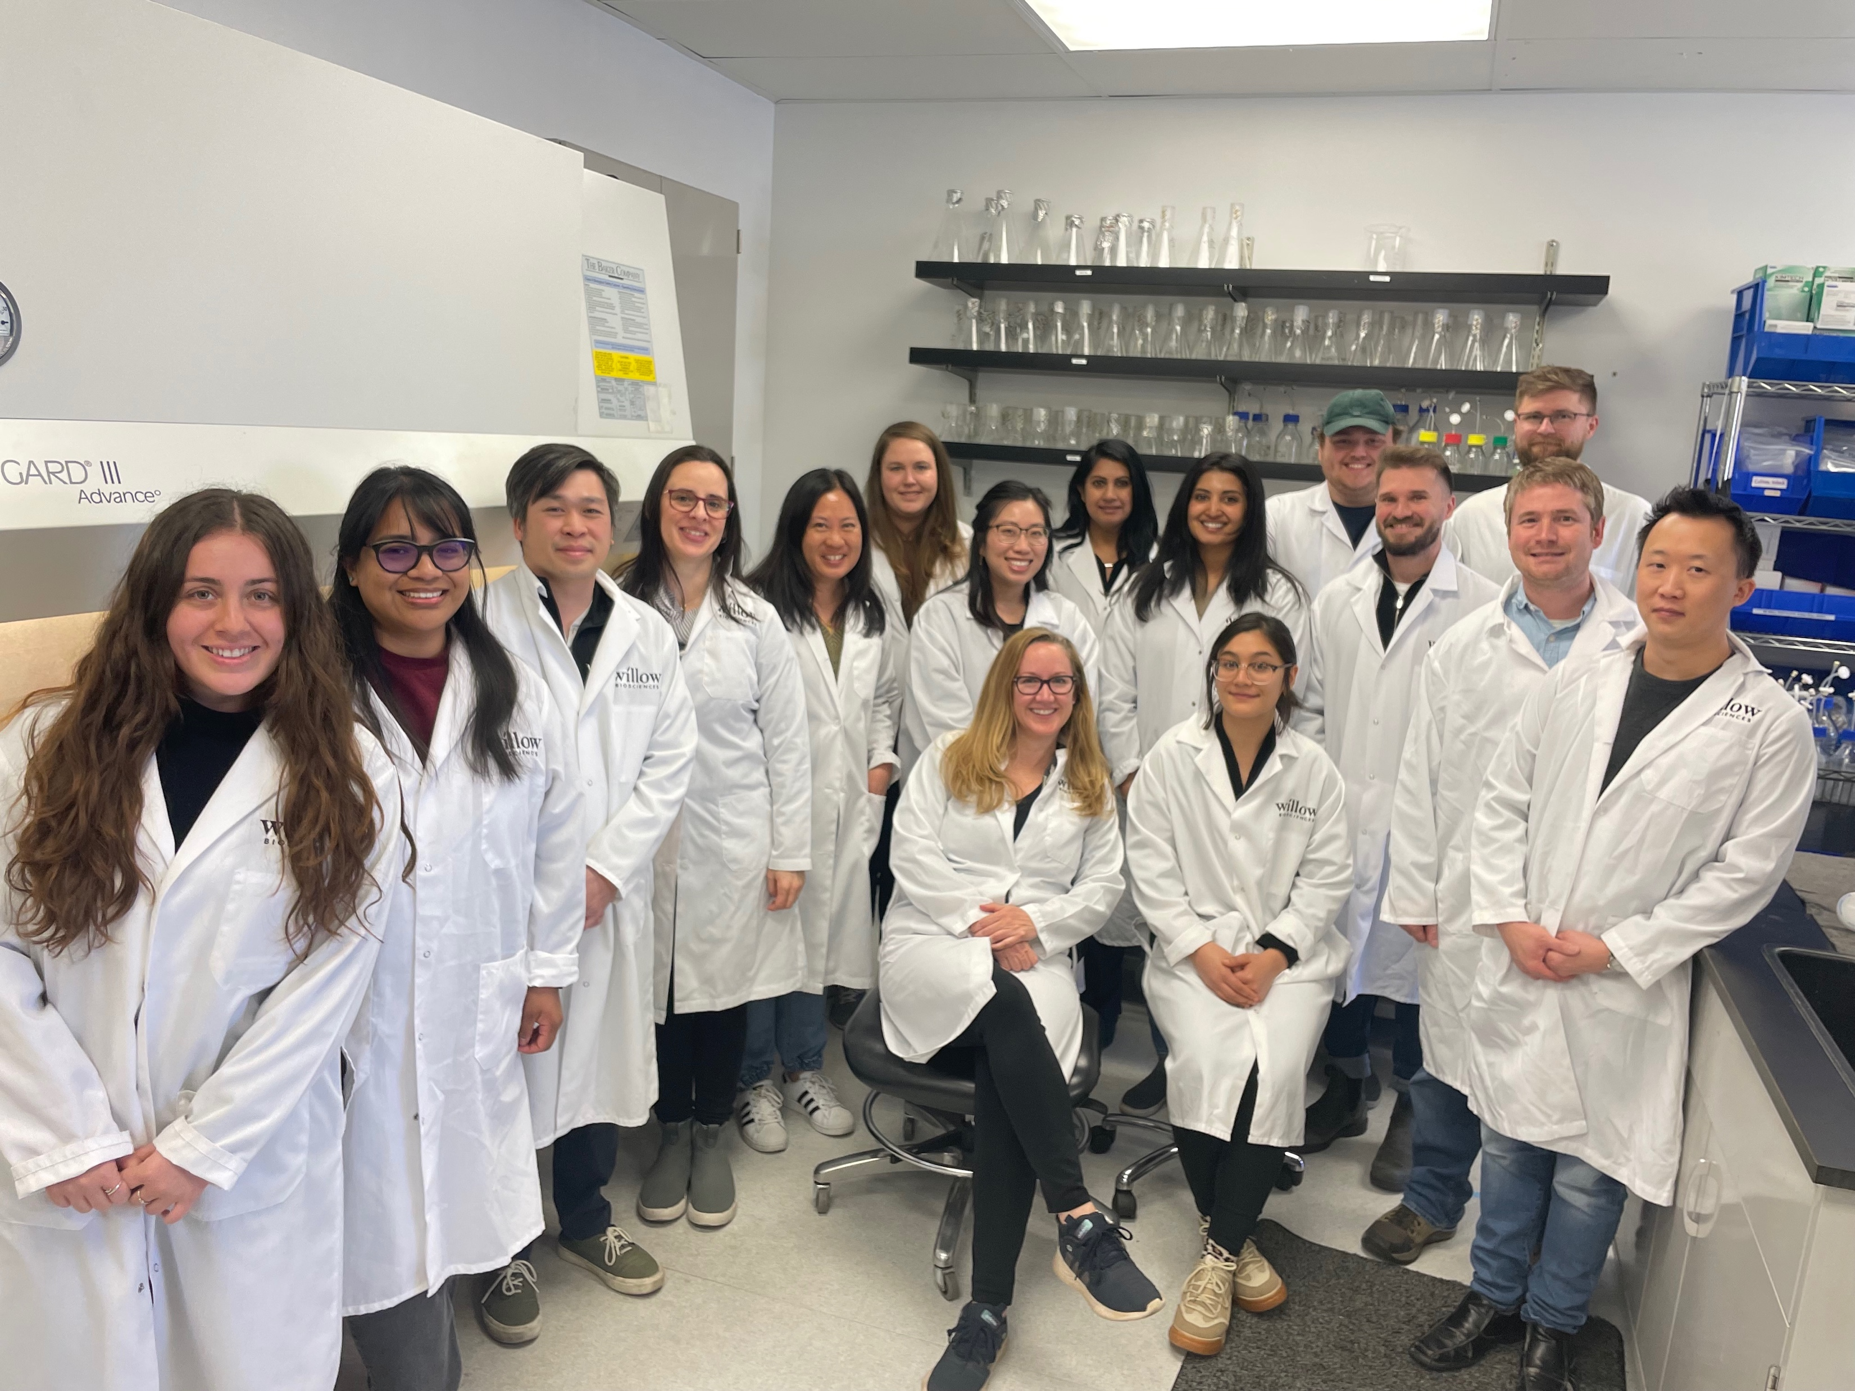
ABOUT WILLOW BIOSCIENCES
SUSTAINABLE PRODUCTS AND INGREDIENTS FOR A BETTER FUTURE
Willow applies its FutureGrownTM and BioOxiTM technologies to develop precision fermentation processes for commercial manufacturing
Focused on high value functional ingredients for the personal care, food & beverage, and pharmaceutical markets produced sustainably at lower cost
Complete lab-to-manufacturing solution
Pipeline of fully-owned and partnered ingredients
Research & Development is strategically located in San Francisco Bay Area
Network of global manufacturing partners
~30 staff, with ~75% in scientific and technical roles
IPO in April 2019: TSX: WLLW
3
TSX: WLLW / OTCQB: CANSF

Slide 4


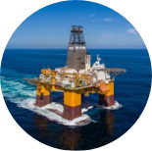
REPLACING EXTRACTION AND SYNTHESIS WITH PRECISION FERMENTATION
“CELLULAR FACTORIES” FOR MAKING SUSTAINABLE INGREDIENTS
FutureGrownTM is a best-in-class bioengineering platform that can replace:
    Extracts from plant and animal sources (low yield, unsustainable)
    Synthetic ingredients prepared via traditional chemistry (complicated, multi-step, unsustainable)
Extraction, isolation
Sustainable
Secure
Natural
Lower cost
BioOxiTM
Traditional synthesis
Example
Ingredient
Basic Raw Materials
  Traditional manufacturing routes versus FutureGrownTM precision fermentation

Slide 5
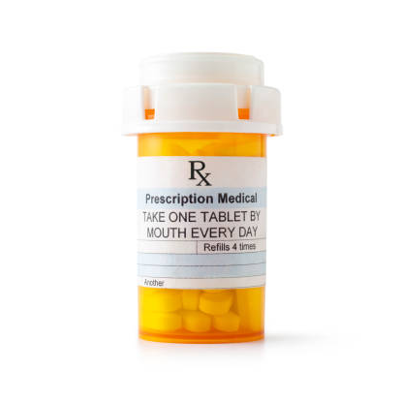


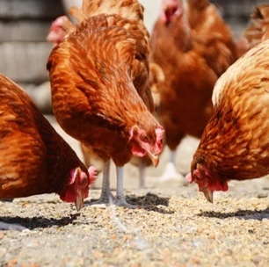

THE OPPORTUNITY: FUNCTIONAL INGREDIENTS
SUSTAINABLE PRODUCTS AND INGREDIENTS FOR A BETTER FUTURE
Our technology replaces unsustainably produced ingredients at lower cost across multiple market segments
Pharmaceutical APIs
>$5 billion market
Replaces synthetic processes with efficient, cost-effective, sustainable routes
Natural Food Preservatives
~$0.5 billion market
Replaces synthetic ingredients with clean label
Cannabinoids
Supplements
Food
Preservatives
FutureGrownTM
BioOxiTM
Dietary Supplements
~$1.5 billion market
Replaces extracted / synthetic ingredients and brings new natural ingredients to market
Food & Feed
>$3.0 billion market
Replaces synthetic with natural food and coloring ingredients
Flavor &
Fragrance (F&F)
Carotenoids
Cannabinoids
~$1.0 billion market
Replaces unsustainable chemical and extraction processes
TSX: WLLW / OTCQB: CANSF
5

Slide 6
WILLOW’S PIPELINE
FUNCTIONAL INGREDIENTS REPLACING UNSUSTAINABLE PLANT AND ANIMAL SOURCES
Ingredient | R&D | Pilot | Commercial
Cannabigerol
Dietary / Pharma API (w/confidential)
New proprietary program
New partnered program (w/undisclosed)
UDCA (w/Sandhill One)
Food ingredient (w/Kalsec)
New partnered program (w/undisclosed)
New partnered program (w/undisclosed)
Proprietary program
Beverage ingredient (w/Kalsec)
Launched
Biosynthesis
Ongoing partnering discussions
Late-stage negotiations
2H2024
2H2024
Late-stage negotiations
Bioconversion
Late-stage negotiations
1H2024
6

Slide 7
PATH TO COMMERCIAL SUCCESS
2023
  Continue to grow and diversify pipeline of ingredients
  Execute on current programs to enable commercial launch and revenue in 2024
  Grow R&D and milestone revenue through additional and expanded partnerships
2024
  First commercial revenues from partnered product(s)
  Grow R&D and product revenue
  Grow R&D team and manufacturing network to enable broader pipeline
2025
  Substantial growth in product revenue from Bioconversion programs
  Initial product revenue from partnered Biosynthesis programs
  Healthy mix of R&D, Product, and Royalty revenue
TSX: WLLW / OTCQB: CANSF
7

Slide 8
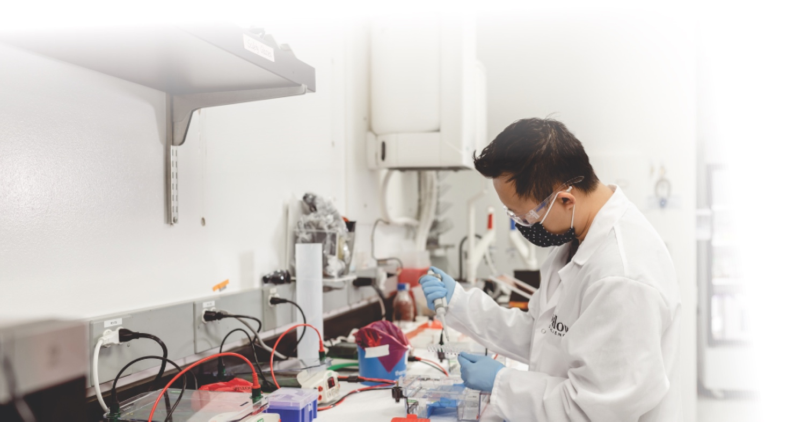
CAPITAL MARKET SUMMARY
Over CAD$65.0 million raised to date with Management and Board
investing more than $8.0 million personally into Willow
Willow share capitalization (TSX: WLLW) - As of May 11, 2023
Uplisted to the TSX Main Board in 2019 (TSX: WLLW) and trade on the OTCQB® Venture Market (OTCQB: CANSF)
Basic shares outstanding
124.2
Employee options, PSU’s and RSU’s¹
9.1
$10.5 million and no debt as of March 31, 2023
Performance warrants²
15
.0
Strong insider ownership at just under 30%
Incentive performance warrants³
12.1
Funded to commercialize production and expand portfolio
Fully diluted shares outstanding
160.3
1. Weighted average strike price of $1.18 for options.
2. 15.0mm issued in the April 2019 financing to strategic investors, management and board with a 5 year term.
These warrants have a strike price of $0.88 per share. 1.0mm broker warrants issued in connection with the February
2021 financing with a 2 year term, strike price of $2.15 per warrant and the ability for Willow to force convert at a 20
day VWAP of $3.05. Remaining warrants have a weighted average strike price of $4.00 per share.
3. Additional warrants issued if the 20 day VWAP exceeds a share price of $3.50 per share and Willow is listed
on the TSX (or equivalent exchange).
TSX: WLLW / OTCQB: CANSF
8

Slide 9
Thank you!
Chris Savile, Ph.D.
Chief Executive Officer
info@willowbio.com

