Slide 1


2024
Owlet - A First Look
May, 2024

Slide 2
Disclaimer
About this Presentation
This presentation is being provided to you without any material non-public information of Owlet, Inc. (the “Company”), and is based solely upon information previously provided by the Company in its public releases, filings and announcements.. The Company’s management may not be able to provide information you request, in observance of U.S. securities laws, including Regulation FD. This presentation shall not constitute an offer to buy securities of the Company, nor a recommendation to buy any securities of the Company.
Forward-Looking Statements
Certain statements in this presentation may constitute “forward-looking statements” within the meaning of federal securities laws, including the Private Securities Litigation Reform Act of 1995, as amended (the “Reform Act”). Forward-looking statements generally relate to projected or future events or the Company’s projected or future financial, operating or business performance. For example, statements regarding the Company’s financial outlook for future periods, expectations regarding regulatory approvals and other developments with applicable regulatory authorities, the competitive environment in which the Company operates and projected future financial, operating and business performance, including expectations for 2024 and long-term strategies and opportunities, and expected sources and uses of liquidity are forward-looking statements, among others. In some cases, you can identify forward-looking statements by terminology such as “pro forma,” “outlook,” “guidance,” “may,” “should,” “could,”, “might,” “plan,” “possible,” “project,” “strive,” “budget,” “forecast,” “expect,” “intend,” “estimate,” “anticipate,” “believe,” “predict,” “potential,” or “goal,” or the negation or variation thereof or similar terminology. Forward-looking statements are based on the Company’s expectations at the time such statements are made, speak only as of the dates made and are subject to risks, uncertainties and other factors. The Company’s actual results, performance or achievements may differ materially from those expressed or implied by the Company’s forward-looking statements. For all of its forward-looking statements, the Company claims the protection of the safe harbor for forward-looking statements contained in the Reform Act.
The Company’s forward-looking statements are based upon estimates and assumptions that, while considered reasonable by the Company and its management, are inherently uncertain. Factors that may cause actual results, performance or achievements to differ materially from current expectations include, but are not limited to: (1) the Company’s competition and ability to profitably grow and manage growth; (2) the regulatory pathways for the Company’s products and responses from regulators, including the U.S. Food and Drug Administration and similar regulators outside of the United States, as well as legal proceedings and regulatory requirements; (3) risks associated with the Company’s loan and/or other debt agreements, including compliance with debt covenants, restrictions on our ability to raise capital, the impact of our overall debt levels and the Company’s ability to generate sufficient cash flow to meet its debt service obligations and operate its business; (4) the ability of the Company to maintain relationships with customers, manufacturers and suppliers and retain the Company’s management and key employees; (5) changes in applicable laws or regulations; (6) the possibility that the Company may be adversely affected by other economic, business, regulatory, competitive and/or other factors, such as changes in discretionary consumer spending and consumer preferences; (7) the ability of the Company to implement its strategic initiatives, innovate its existing products and adapt to changes in consumer preferences and industry and retail trends; (8) the ability of the Company to acquire, defend and protect its intellectual property and satisfy regulatory requirements, including but not limited torequirements concerning privacy and data protection and risks associated with the Company’s digital platforms and technologies; (9) the impact of and disruption to the Company’s business, financial condition, operations and supply chain due to economic and other conditions beyond the Company’s control, such as health epidemics or pandemics, inflationary pressures, social unrest, hostilities, natural disasters or other catastrophic events; and (10) other risks and uncertainties set forth in the Company’s releases, public statements and/or filings with the Securities and Exchange Commission, including those identified in the “Risk Factors” sections of the Company’s Annual Report on Form 10-K for the year ended December 31, 2023 and subsequent Quarterly Reports on Form 10-Q. Therefore, such statements are not intended to
be a guarantee of the Company’s results, performance or achievements in future periods, and you should not place undue reliance on these forward-looking statements, which are made only as of the date of this presentation. The Company undertakes no obligation to update or revise any forward- looking statements, whether as a result of new information, future events or otherwise, except as required by applicable law.
Certain information contained in this presentation may be derived from information provided by industry sources. The Company believes such information is accurate and that the sources from which it has been obtained are reliable. However, the Company cannot guarantee the accuracy of, and has not independently verified, such information. All trademarks, service marks, and trade names appearing in this presentation are the property of their respective holders.
Non-GAAP Financial Measures
In addition to financial measures presented in accordance with U.S. Generally Accepted Accounting Principles (“GAAP”), this presentation also includes certain non-GAAP financial measures, including EBITDA, adjusted EBITDA, adjusted net loss and adjusted net loss per share. The Company uses such non-GAAP financial measures as internal measures of business operating performance and as performance measures for benchmarking against the Company’s peers and competitors. The Company believes its presentation of EBITDA, adjusted EBITDA, adjusted net loss and adjusted net loss per share provide a meaningful perspective of the underlying operating performance of our current business and enables investors to better understand and evaluate our historical and prospective operating performance. The Company believes that these non-GAAP financial measures are important supplemental measures of operating performance because they exclude items that vary from period to period without correlation to our core operating performance and highlight trends in our business that may not otherwise be apparent when relying solely on GAAP financial measures. Due to the nature of the items being excluded, such items do not reflect future gains, losses, expenses or benefits and are not indicative of the Company’s future operating performance. The Company believes investors, analysts and other interested parties use EBITDA, adjusted EBITDA, adjusted net loss and adjusted net loss per share in evaluating issuers, and the presentation of these measures facilitates a comparative assessment of the Company’s operating performance in addition to the Company’s performance based on GAAP results. The Company’s non-GAAP financial measures should not be considered as an alternative to net loss or net loss per share as a measure of financial performance or any other performance measure derived in accordance with GAAP, and should not be construed as an inference that the Company’s future results will be unaffected by unusual or non-recurring items. EBITDA is defined as net loss adjusted for income tax provision, interest expense, interest income, and depreciation and amortization. Adjusted EBITDA is defined as net loss adjusted for income tax provision, interest expense, interest income, depreciation and amortization, warrant liability adjustments, stock-based compensation and transaction costs. Adjusted net loss is defined as net loss adjusted for warrant liability adjustments, stock-based compensation and transaction costs. Adjusted loss per share is defined as adjusted net loss divided by weighted-average shares of common stock. EBITDA, adjusted EBITDA, adjusted net loss and adjusted net loss per share are not recognized terms under GAAP, and the Company’s presentation of these non-GAAP financial measures does not replace the presentation of the Company’s financial results in accordance with GAAP. Because all companies do not use EBITDA, adjusted EBITDA, adjusted net loss and adjusted net loss per share (and similarly titled financial measures) in the same way, those measures as used by other companies may not be consistent with the way the Company calculates such measures. The non-GAAP financial measures included in this presentation should not be construed as substitutes for or better indicators of the Company’s performance than the most directly comparable GAAP financial measures. The Company provides a reconciliation of certain historical non-GAAP measures to the most directly comparable GAAP measures, which is available in the earnings press release for the relevant period and in the appendix of this presentation.

Slide 3



2024
| 3
140M Babies Born Each Year Globally⁽¹⁾ -
Every Parent Has The Same Questions & Concerns
Safety*
Sickness*
Sleep
Are they breathing?
When should I call my doctor?
Will we ever sleep again?
SIDS: #1 cause of death in infants 1-12 months old⁽²⁾
Infant parents experience more than three million emergency care visits per year.⁽³⁾
Respiratory issues--#1 reason for pediatric ER visits⁽⁴⁾
According to survey, parents may lose 133 nights of sleep during the first year of a baby's life⁽⁵⁾
Majority of new parents get 5-6 hours of sleep per night⁽⁶⁾
____________________
Sources:
2022 - https://population.un.org/wpp/Download/
2011 - https://www.ncemch.org/suid-sids/statistics/index.php
2015 - https://www.ncbi.nlm.nih.gov/books/NBK526418/
2015 - https://www.ncbi.nlm.nih.gov/books/NBK526418/
2021 https://www.parents.com/news/survey-shows-parents-lose-a-total-of-133-nights-of-sleep-in-babys-first-year/
https://www.healthline.com/health/parenting/new-parent-sleep-study
Notes:
NOTE: “Privileged and Confidential” needs to be removed from the final version of this deck. This is mean for public use and as such cannot be privileged (which is for advice of counsel). So, please remove this from header on the FINAL VERSION. As such, this should ONLY include information that Owlet views as already in the public domain.

Slide 4



2024
| 4
Leading to the highest rate of primary & urgent care utilization
97%
Peace of Mind
Treat & Release for age 0-1
126M
Pediatric Visits in the US/year
Inconvenient process just to know - if baby is ok
2 Hrs Round Trip
Exposure to Sickness
$1.38K ER Visit
Is Baby Okay?
What if these visits could be addressed in the home?
https://www.ncbi.nlm.nih.gov/books/NBK526418/table/sb242.tab2/?report=objectonly
https://www.usatoday.com/story/news/health/2019/06/04/hospital-billing-code-changes-help-explain-176-surge-er-costs/1336321001/
https://www.graham-center.org/content/dam/rgc/documents/publications-reports/reports/PrimaryCareChartbook2021.pdf (page 19 & 20)

Slide 5
Over 70M Adults have a wearable to track their health. Parents want the same information for their children.
https://www.nhlbi.nih.gov/news/2023/study-reveals-wearable-device-trends-among-us-adults#:~:text=Almost%20one%20in%20three%20Americans,Health%20Information%20National%20Trends%20Survey.

Slide 6
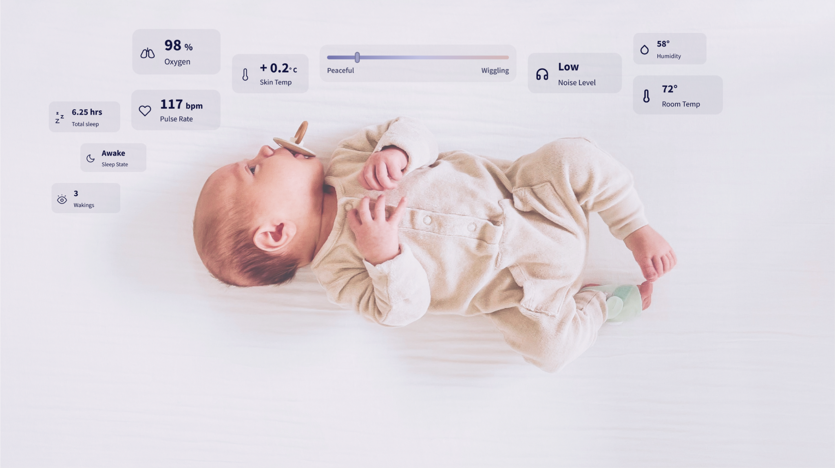
Owlet’s Dream Sock is the first FDA cleared, over-the-counter monitor for pediatric health at home.
2024
| 6

Slide 7
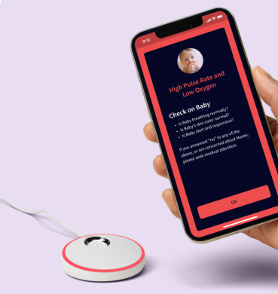
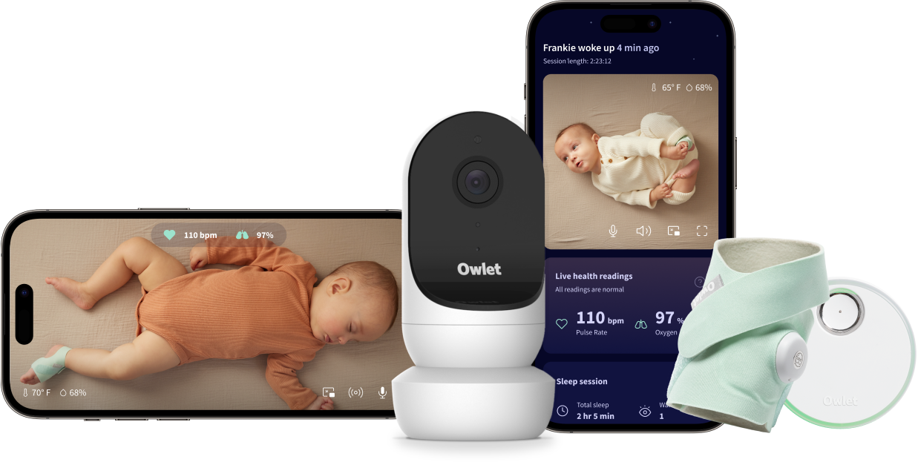
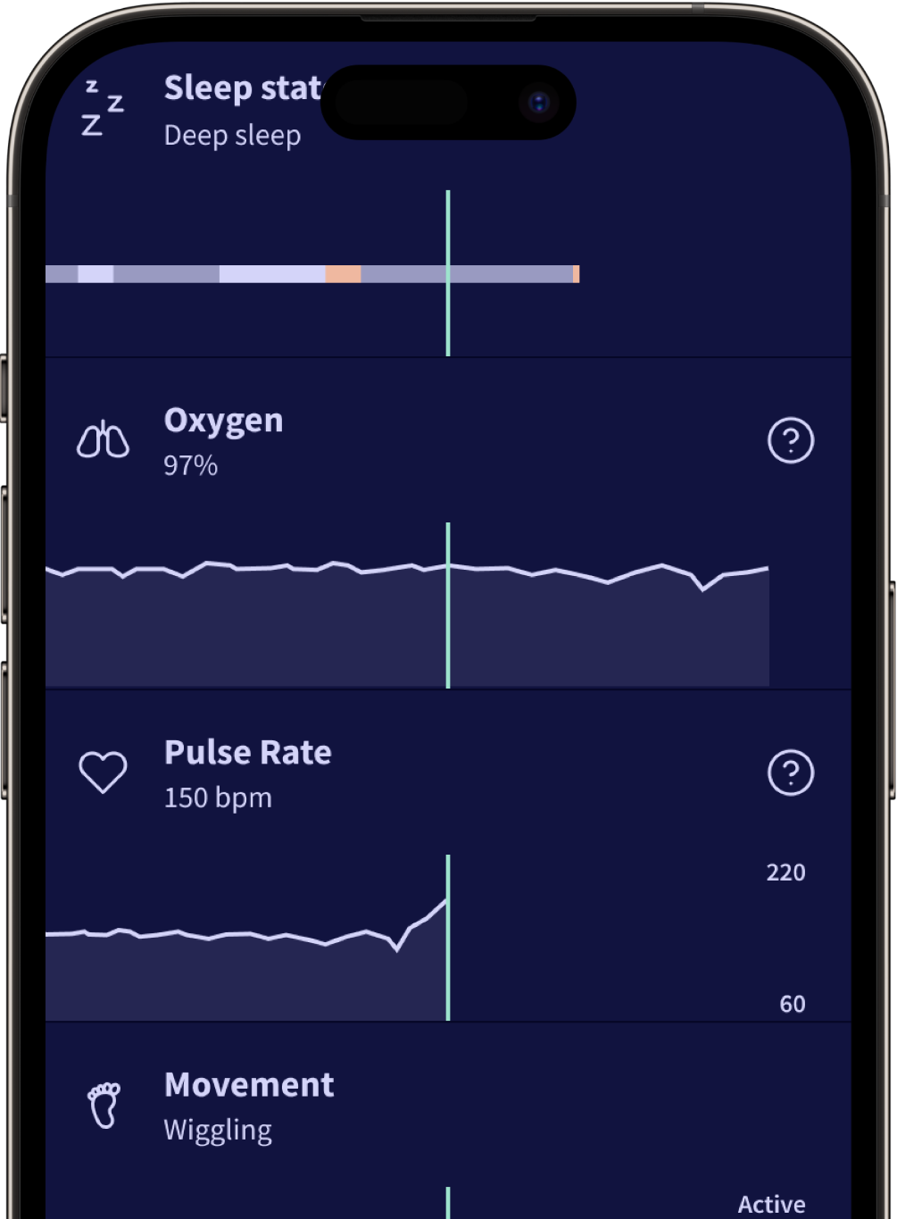

2024
| 7
Safety
Helping Answer Parents Most Important Questions
Health
Sleep

Slide 8
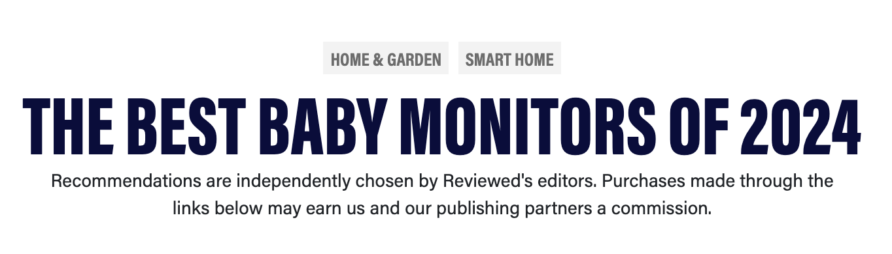
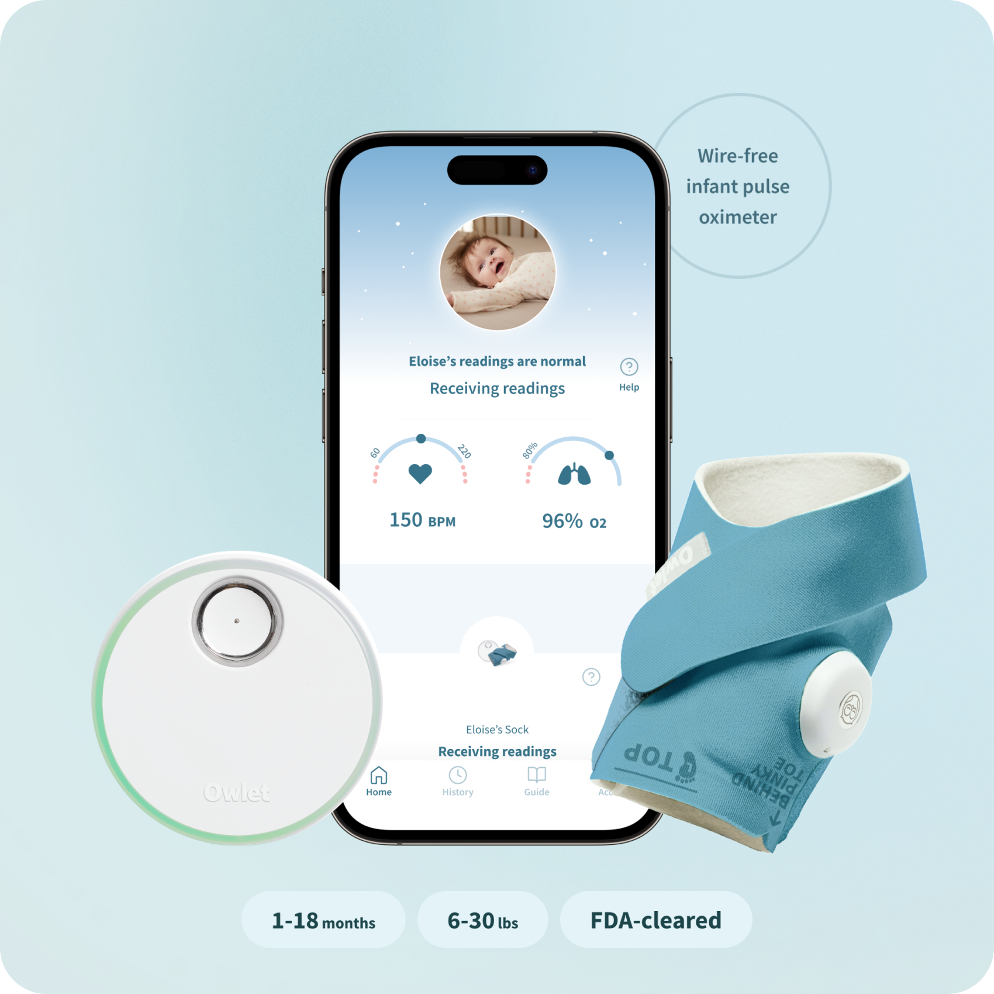


2024
| 8
With Consumer & Medical Distribution Opportunities
Consumer: Dream Sock
Medical: BabySat
For healthy infants up to 18 months old.
Sold over the counter.
For sick and high risk infants up to 18 months old that doctors can prescribe, reimbursable by insurance.
Current Distribution:
Owlet Online
Amazon
Target
Walmart
BabyList
Distribution Opportunities:
DME Channels
Telehealth Partnerships
Provider Networks
Children’s Hospitals
Insurance Reimbursement

Slide 9

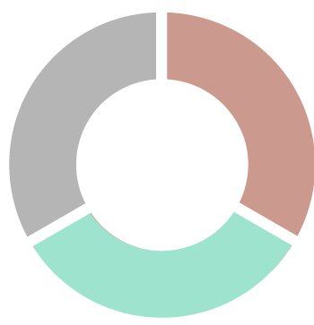


Leading the market in brand, position and IP
2024
| 9
#1 Brand in
Infant Health
Healthy
Business
“First of its Kind” Regulatory Authorizations
#1
Health Monitor
70 nps
Product NPS
$73M
2023 Gross Sales
3
FDA Authorizations & CE Mark
500k
Users in 2023
12+
Clinical & Safety Studies
Largest & Most
Engaged Community
$XB
Market Size
The Data Flywheel
Largest Data Set Of Infant Health
More Data
Better
Products
Clinical Insights
1.3M+
Followers on social media
2M+
Devices Sold
58
Issued
Patents
100M+
Views & Engagements in 2023
More Products
Purchased
The NPD Group, Inc./U.S. Retail Tracking Service, Baby Monitors, Q4 2023

Slide 10
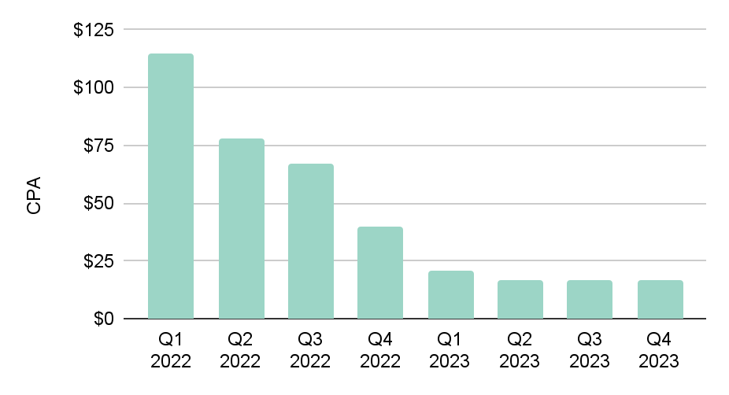
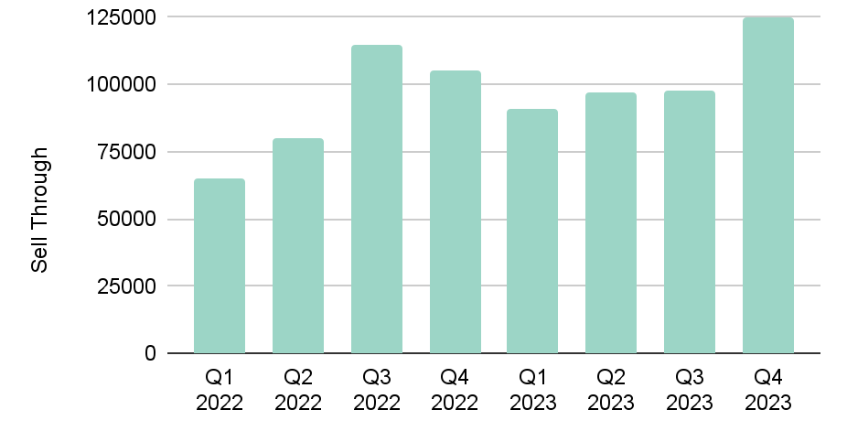
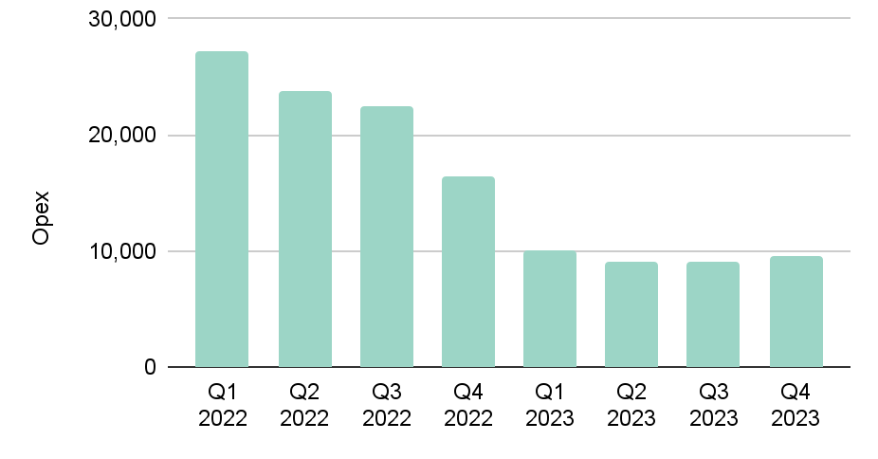
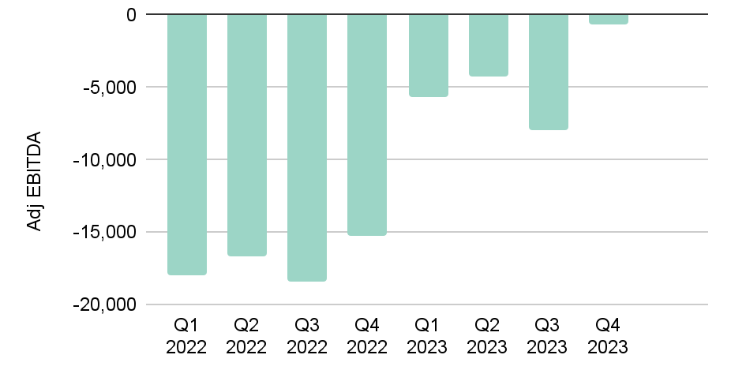
Operational Leverage from growing demand and reducing cost.
2024
| 10
CPA (-80%)
Sell Through (+20%)
*Prime Day
*If sell through makes conservative 5-7% growth QoQ while reducing opex and CPA owlet will successfully reach profitability.
We continue to improve the financial profile of our business after overcoming significant regulatory and macroeconomic challenges. The improved efficiency with the new growth from FDA clearances is setting up an exciting opportunity for 2024+.
Opex Ex SBC (-67%)
Adj EBITDA (-$15M to -$0.7M)
*Excluding stock based comp
*Q3 & Q4 2022 included significant cleanup from prior periods
| 10

Slide 11
Accelerating Growth & Profitability
2024
| 11
KEY AREAS OF GROWTH
TARGET OPERATING MODEL
Adoption from FDA & EU med device authorizations
Medical Channels
Subscription
Medical
Subscription
Core Growth
2023
MARGIN CONTRIBUTION
Subscription
Medical Channels
Dream Sock Adoption
Medical Channels and Subscription both add significant margin opportunities for the business

Slide 12








Owlet Team
Executives
Kurt Workman
Founder/CEO
Jonathan Harris
President/CRO
(GoPro & Roku)
Kate Scolnick
CFO
(Anaplan & Seagate)
Burc Sahinoglu
CTO
(Yale & August)
Board Independents
Melissa Gonzales
President Myriad Genetics
(President @ Medela)
Zane Burke
CEO of Quantum
(CEO @Livongo / Cerner)
John Kim
CPO at Paypal
(President @ Expedia)
Laura Durr
CFO Polycom
(AC @ Netgear)

Slide 13
2024
| 13
Thank You

