Slide 1



Emerging Growth Conference
September 2024

Slide 2
Disclaimer and Forward-Looking Statements
Forward Looking Statements
The information in this presentation includes “forward-looking statements” that are made pursuant to the Safe Harbor Provisions of the Private Securities Litigation Reform Act of 1995. All statements, other than statements of historical fact included in this presentation, regarding our strategy, future operations, financial position, projected costs, prospects, plans and objectives of management are forward-looking statements. When used in this presentation, the words “could,” “believe,” “anticipate,” “intend,” “estimate,” “expect,” “may,” “continue,” “predict,” “potential,” “project” and similar expressions are intended to identify forward-looking statements, although not all forward-looking statements contain such identifying words. These forward-looking statements are based on U.S. Energy Corp.’s (“USEG’s” or the “Company’s”) current expectations and assumptions about future events and are based on currently available information as to the outcome and timing of future events. We caution you that these forward-looking statements are subject to all of the risks and uncertainties, most of which are difficult to predict and many of which are beyond our control, incident to the exploration for and development, production, gathering and sale of oil and natural gas. These risks include, but are not limited to, risks associated with the integration of the recently acquired Wavetech assets; the Company’s ability to recognize the expected benefits of the acquisitions and the risk that the expected benefits and synergies of the acquisition may not be fully achieved in a timely manner, or at all; the amount of the costs, fees, expenses and charges related to the acquisitions; the Company’s ability to come to definitive agreement terms with Synergy, obtain shareholder approval for the Synergy transaction and close such proposed transaction, variations in the market demand for, and prices of, crude oil, NGLs and natural gas, lack of proved reserves, estimates of crude oil, NGLs and natural gas data, the adequacy of our capital resources and liquidity including, but not limited to, access to additional borrowing, borrowing capacity under our credit facilities, general economic and business conditions, failure to realize expected value creation from property acquisitions, uncertainties about our ability to replace reserves and economically develop our reserves, risks related to the concentration of our operations, drilling results, potential financial losses or earnings reductions from our commodity price risk management programs, potential adoption of new governmental regulations, our ability to satisfy future cash obligations and environmental costs and the other risk factors discussed in or referenced in our filings with the United States Securities and Exchange Commission (“SEC”), including our 2023 Annual Report on Form 10-K, our Quarterly Reports on Form 10-Q, and our Current Reports on Form 8-K in each case as amended. These reports are available at www.sec.gov.
You are cautioned not to place undue reliance on any forward-looking statements, which speak only as of the date of this presentation. Except as otherwise required by applicable law, we disclaim any duty to update any forward-looking statements, all of which are expressly qualified by the statements in this section, to reflect events or circumstances after the date of this presentation.
All information in this presentation is as of September 23, 2024 (unless otherwise stated). The Company undertakes no duty to update any forward-looking statement to conform the statement to actual results or changes in the Company’s expectations.
Our production forecasts and expectations for future periods are dependent upon many assumptions, including estimates of production decline rates from existing wells and the undertaking and outcome of future drilling activity, which may be affected by significant commodity price declines or cost increases.
The presentation which follows discusses the Company’s recently completed acquisition of approximately 140,000 net acres from Wavetech Helium Inc. (“Wavetech”)
Industry and Market Data
This presentation has been prepared by USEG and includes market data and other statistical information from third-party sources, including independent industry publications, government publications or other published independent sources. Although USEG believes these third-party sources are reliable as of their respective dates, USEG has not independently verified the accuracy or completeness of this information and has not commissioned any such information. Some data is also based on USEG’s good faith estimates, which are derived from its review of internal sources as well as the third-party sources described above.
This document and any related presentation do not constitute an offer or invitation to subscribe for or purchase any securities, and it should not be construed as an offering document. Any decision to purchase securities in the context of a proposed offering, if any, should be made on the basis of information contained in the offering document related to such an offering. This presentation does not constitute a recommendation regarding any securities of U.S. Energy Corp.

Slide 3
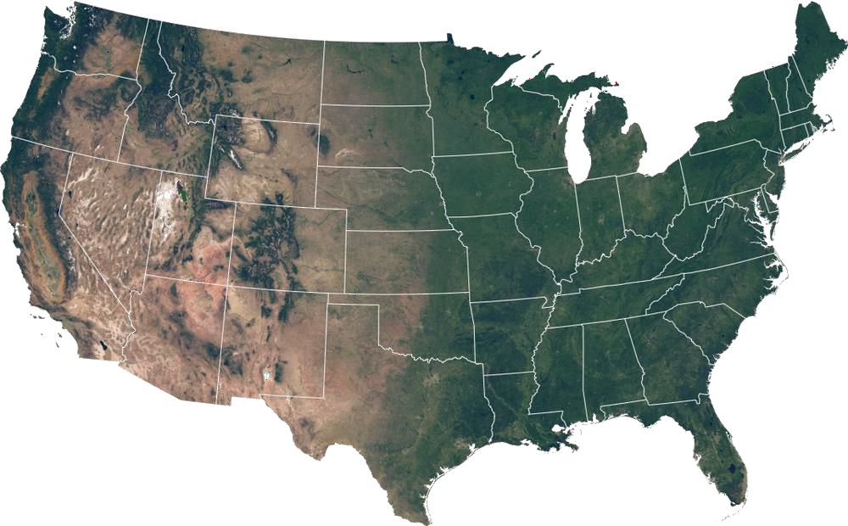
U.S. Energy Overview
U.S. Energy operates a portfolio of high-quality producing energy assets that allows the Company to execute on an attractive capital returns program to shareholders
Company Overview
Where We Operate
NASDAQ | USEG
Shares Outstanding | 28.1 million
Share Price ⁽¹⁾ | $0.97
Market Cap ⁽¹⁾ | $27 million
Enterprise Value ⁽¹⁾ | $25 million
Proved Reserves, 2Q 2024⁽²⁾ | 3.5 MMBOE (100% PDP)
Proved PV-10⁽²⁾ | $50.9 million
Average Daily Production | 1,100
% Oil | 62%
Total Resource: ⁽³⁾ |  | Helium (Bcf)
1C and 1U | 2,264 | 16
2C and 2U | 4,031 | 37
3C and 3U | 5,085 | 79
Selected Pay Zone Formations: Upper Duperow, Middle Duperow, Lower Duperow, Souris River and Flathead
Cash | $2.0 million
Debt | $0.0 million
Borrowing Availability | $20.0 million
Total Liquidity | $22.0 million
Industrial Gases (Bcf)
Headquarters
Houston, TX
Legend:
 | Industrial Gases and Helium
 | Hydrocarbons
Market cap and share price as market close on 9/23/2024.
Reserves effective 7/1/2024 at 2q2024 SEC pricing.
Total resource includes both contingent and perspective resources. Industrial gases primarily CO₂ and Nitrogen.

Slide 4




A Differentiated Small-Cap E&P Investment
Track Record of Executing Transactions to Drive
Increased Critical Mass
Eight acquisitions since 2020 increased production by ~4x and improved cost and operating efficiencies
Proven Basins /
Long Life Assets
Rockies and Texas assets featuring low decline industrial gas and oil-weighted production
Free Cash Flow Generation with
Low Reinvestment Needs
Legacy assets create robust free cash flow generation and drives capital redeployment to existing initiatives
Pristine
Balance Sheet
No outstanding debt, $20mm undrawn borrowing base, and cash flow from operations drives liquidity
Focused on
Shareholder Returns
Ongoing shareholder repurchase program accelerates shareholder returns
Committed to
Environmental Excellence
Minimizing fugitive emissions through pro-active and economic infrastructure ownership

Slide 5






Expanding Helium Market - Application in High-Growth Sectors
Helium Applications and Demand
United States Helium Demand
Helium is utilized in multiple vital industries such as semi-conductor manufacturing, aerospace and defense, and healthcare, among many others.
Annual global helium demand is expected to increase from 5.9 BCF in 2023 to 8.7 BCF in 2030.
Immediate opportunity in United States to replace declining supplies of legacy hydrocarbon-based helium projects.
Technology Manufacturing
Aerospace & Defense
Space Exploration
Fuel Purging Systems
Defense and Rocket Guidance Systems
Helium Demand by Region
Semiconductor manufacturing
LCD Panels
Fiber optics cables
N America 2.0 Bcf
Europe 1.2 Bcf
Asia 2.2 Bcf
Healthcare &
Life Sciences
Industrial Uses
MRI Scanners
Microscopy
Quantum Computing
Assisted Breathing
Cryogenics
Welding, shield masks
Gas leak detection
Nuclear reactor coolant
Crystal growth
Controlled Atmosphere
S. America 0.1 Bcf

Slide 6





U.S. Energy – Recent Transaction Overview
U.S. Energy recently announced a transformative transaction targeting helium and other industrial gas production.
Transaction Overview
Near-Term Estimated Timeline
Asset of 140,000 operated acres targeting helium and other industrial gas production located across the prolific Kevin Dome reservoir. Industry leading low environmental footprint through production of non-hydrocarbon helium. Multiple prospective pay zones.
June
2024
September
2024
Spring
2025
Closed Transformative Acquisition
Initiated Development Program
Continue program and begin plant construction
Integration Integrated Helium and carbon sequestration growth opportunities underpinned by value of legacy E&P assets | De-risked Active wells, known helium concentrations, and proved reserves de-risk the project | Growth Catalysts Clear and understood go-forward development catalysts associated with project | Diversification Diversification of business operations / cash flow streams | Scaling Scalable project with tremendous upside potential in helium production plus multiple other potential revenue streams

Slide 7



Overview of the Asset
Asset Details
Detailed Contingent and Prospective Resources ⁽¹⁾
140,000 net acres.
Development program recently initiated.
Low drilling cost anticipated of $1.4 million per well.
Initially target nitrogen-based pay zone.
 | Discovered Gas Initially in Place (Bcf) |  |  |  | Remaining Helium Resource (Bcf)
*Company gross | 1C (Low) | 2C (Best) | 3C (High) |  | 1C (Low) | 2C (Best) | 3C (High)
Contingent Resources
Upper Duperow | 1,293 | 1,947 | 2,904 |  | 8 | 17 | 32
Middle Duperow | 428 | 806 | 1,459 |  | 3 | 7 | 15
Total Contingent | 1,721 | 2,753 | 4,363 |  | 11 | 24 | 46
 | 1U (Low) | 2U (Best) | 3U (High) |  | 1U (Low) | 2U (Best) | 3U (High)
Prospective Resources
Souris River | 428 | 995 | 21 |  | 3 | 9 | 22
Flathead | 114 | 283 | 702 |  | 2 | 4 | 11
Total Prospective | 543 | 1,278 | 722 |  | 5 | 13 | 32
Total Resources | 2,264 | 4,031 | 5,085 |  | 16 | 37 | 79
Transaction Consideration ⁽¹⁾
U.S. Energy acquired 82.5% of Seller’s ownership in its acreage for:
$2.0mm cash.
2,600,000 shares of USEG restricted common stock.
$20.0mm carried working interest for 17.5% retained working interest.
U.S. Energy has an 82.5% working interest across the acreage position.
417

Slide 8
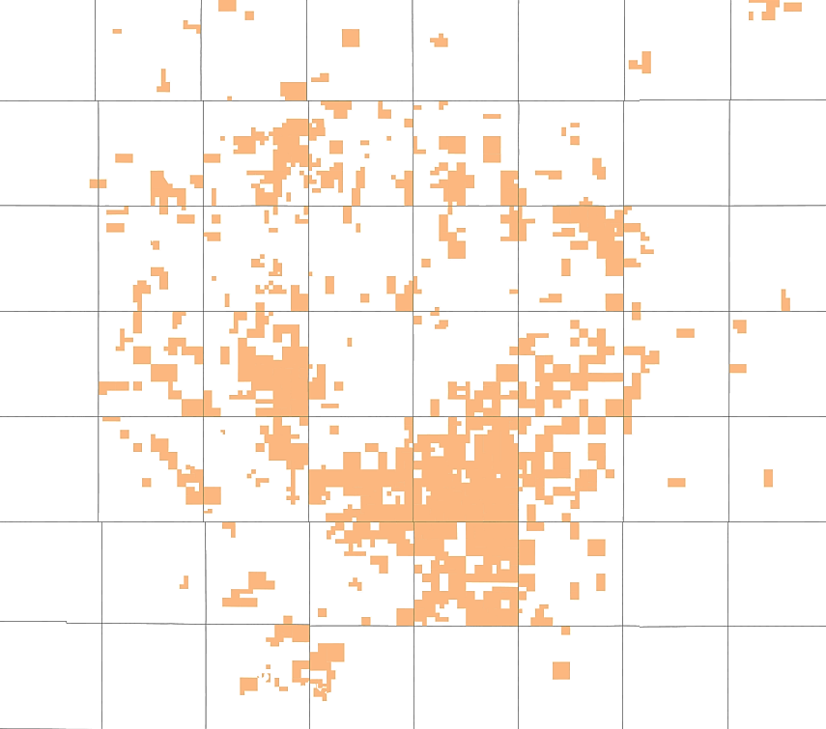
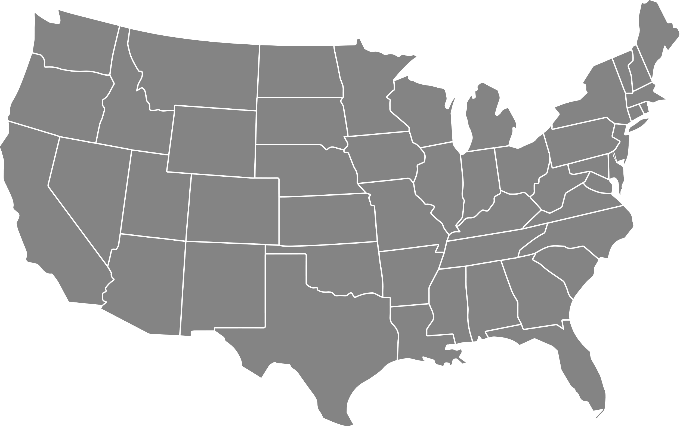



Large Scale Acreage Position
Vast acreage position stretching across the resource rich Kevin Dome in Northwest Montana.
U.S. Energy Acreage Position
Highlights
140,000 acres of targeted helium resource 100% Operated Multiple prospective helium pay zones Carbon sequestration presents further opportunity
5 mile
 | Asset | Net Acres
 | USEG ⁽¹⁾ | 140,000
Acquired June 26, 2024. As filed in U.S. Energy’s 8-k filed on July 1, 2024.

Slide 9


Project Development – Successful Activity Underway
Current Development
Known Helium Concentrations
Existing USEG Footprint
USEG recently initiated its development program. Nearby well control shows Helium and CO₂ rich Duperow zone. USEG plans to drill multiple wells throughout the current fall season and spring/summer 2025. The wells to be drilled on Company acreage will test multiple pay zones. Anticipating the building of gas processing plant to begin in Spring 2025. |  | 0.6% helium and 85% CO₂ from nearby recent well control. Multiple productive Helium zones, the Duperow, Souris River and Flathead. Helium concentrations projected to be as high as: 1.40% Helium in the nitrogen dominant Flathead Sandstone. 0.87% Helium in the CO₂ rich Duperow zone. |  | USEG has legacy operations in the local Montana community where we expect to develop the project. Familiarity of local markets and infrastructure enables seamless transition into project development. Advantage in sourcing materials and labor from existing platform as significant local employer.
He

Slide 10





Projected Project Timeline
U.S. Energy has a clear, catalyst driven timeline to drive immediate project development.
Initiate development program
Continue development program. Build plant.
June 2024
Sept 2024
Fall 2024
Spring 2025
Fall 2025
Closed transformative transaction
Continue permitting for future project development. Evaluate divestiture opportunities on legacy hydrocarbon assets.
Commission plant and realize helium sales. Continue drilling development.

Slide 11
Helium Grades and Supply Chain
Helium Grades ⁽¹⁾
Grade | Purity | Description
Grade 6 | 99.9999% | Closest to 100% pure helium, used in semiconductor chip manufacturing, lab research laser cutting, MRIs and as a carrier gas in chromatography.
Grade 5.5 | 99.9995% | Like Grade 6 helium, it is generally considered research grade. Similar uses as Grade 6 helium but additionally used in welding and as a cooling gas in fiber optics.
Grade 5 | 99.999% | Laboratory uses such as gas chromatography, mass spectrometry and also used for weather balloons and blimps. First stage that would be liquified.
Grade 4.5-4.8 | 99.995 - 99.998% | Commonly referred to as industrial grade, used in balloons and as a push gas in MRI applications.
Grade 4.0 | 97.5% – 99.99% | Considered balloon grade helium.
Helium Supply Chain
Crude He
~80-90%
Liquefaction
Primary Liquid He Distributors
Pipeline or truck
ISO container and truck
ISO container
ISO container and truck
ISO container and truck
US Ports for Export to Overseas Customers
Large Liquid He Customers
Regional Depots
Other He Customers
1. The first number in the helium grade indicates the number of 9’s in its purity. The second number indicates the number after the last nine. For example: Grade 4.7 = four 9’s followed by a 7, or 99.997%.
417

Slide 12





Conclusion - Strategic Rationale
He
Energy Growth Innovations
Integrated energy company with Helium growth and carbon sequestration opportunities underpinned by value from legacy assets.
Realizable Potential Upside
Clear and understood go-forward development catalysts associated with project.
Value Creation
Transaction immediately increases USEG’s asset value and growth prospects while appealing to a wider range of institutional investors.
Risk Diversification
Prospective multi-zone helium production and carbon sequestration opportunities diversifies the risk of the project across different cash flow streams.
Proven Viability
Third-party engineering reports prove the CO2 and helium reserves and resources, while offset operators and analogous fields confirm Helium viability.
In Area of Current Operations
Current USEG operations in place to support the opportunity in an area with which the Company has a longstanding community footprint.

