Slide 1

Jaguar Health, Inc.
(NASDAQ: JAGX)
Overview – December 2024

Slide 2
Forward-Looking Statements
This presentation contains forward-looking statements. All statements other than statements of historical facts contained in this presentation, including statements regarding plans by Jaguar Health, Inc. (“Jaguar” or the “Company”) and Napo Therapeutics (formerly known as “Napo EU”) to develop and commercialize crofelemer in Europe for HIV-related diarrhea, short bowel syndrome, congenital diarrheal disorders, and other indications, expectations related to the timing of the commercial launch of products in any market, the expectation that Magdalena Biosciences will leverage Jaguar’s proprietary medicinal plant library and Filament Health’s proprietary drug development technology, the expectation that US$1,000,000 will be invested in Magdalena Biosciences by One Small Planet, the expectation that Magdalena Biosciences may develop a potential plant-based alternative drug for adult ADHD or other indications that is both safe and efficacious, Jaguar’s plans to pursue additional business development deals, plans to expand the geography for commercialization of crofelemer, statements related to the powder formulation of crofelemer, related to NP-300, the timing of the initiation, completion, results, and publication of Phase 2 studies, Phase 3 studies, proof-of-concept studies, field studies, investigator-initiated trials, sponsored studies, and other studies, statements about possible eligibility for, and possible participation in, revenue generating early access programs, statements about the planned submission of Investigational New Drug (IND) applications to FDA, statements about plans to pursue a Priority Review Voucher (PRV), statements about the possible future market size/potential of indications, and expected milestones appearing on the list of “Upcoming Milestones”, are forward-looking statements. These statements involve known and unknown risks, uncertainties and other important factors that may cause our actual results, performance or achievements to be materially different from any future results, performance or achievements expressed or implied by the forward-looking statements. In some cases, you can identify forward-looking statements by terms such as “may,” “will,” “should,” “expect,” “plan,” “aim,” “anticipate,” “could,” “intend,” “target,” “project,” “contemplate,” “believe,” “estimate,” “predict,” “potential” or “continue” or the negative of these terms or other similar expressions. The forward-looking statements in this presentation are only predictions. We have based these forward-looking statements largely on our current expectations and projections about future events and financial trends that we believe may affect our business, financial condition and results of operations. These forward-looking statements speak only as of the date of this presentation and are subject to a number of risks, uncertainties and assumptions, some of which cannot be predicted or quantified and some of which are beyond our control. Please see the risk factors identified in our Annual Report on Form 10-K and our other filings with the SEC. The events and circumstances reflected in our forward-looking statements may not be achieved or occur and actual results could differ materially from those projected in the forward-looking statements. Readers are also advised that our projected sales do not take into account the royalties and other payments we will need to make to our licensors and strategic partners. Moreover, we operate in a dynamic industry and economy. New risk factors and uncertainties may emerge from time to time, and it is not possible for management to predict all risk factors and uncertainties that we may face. Except as required by applicable law, we do not plan to publicly update or revise any forward-looking statements contained herein, whether as a result of any new information, future events, changed circumstances or otherwise.
2
NASDAQ:JAGX

Slide 3


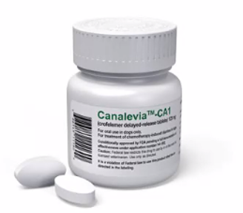

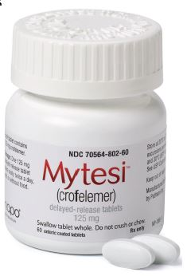
What We Do: Develop New Ways and Novel Plant-based Medicines to Treat Gastrointestinal Disorders
From Tree to Bottle
Crofelemer was discovered through the science of ethnobotany
Canalevia®-CA1 is conditionally approved by the FDA for the treatment of chemotherapy-induced diarrhea in dogs
Mytesi (crofelemer 125mg delayed-release tablets) is FDA-approved for symptomatic relief of noninfectious diarrhea in adults with HIV/AIDS on antiretroviral therapy
3
NASDAQ:JAGX

Slide 4
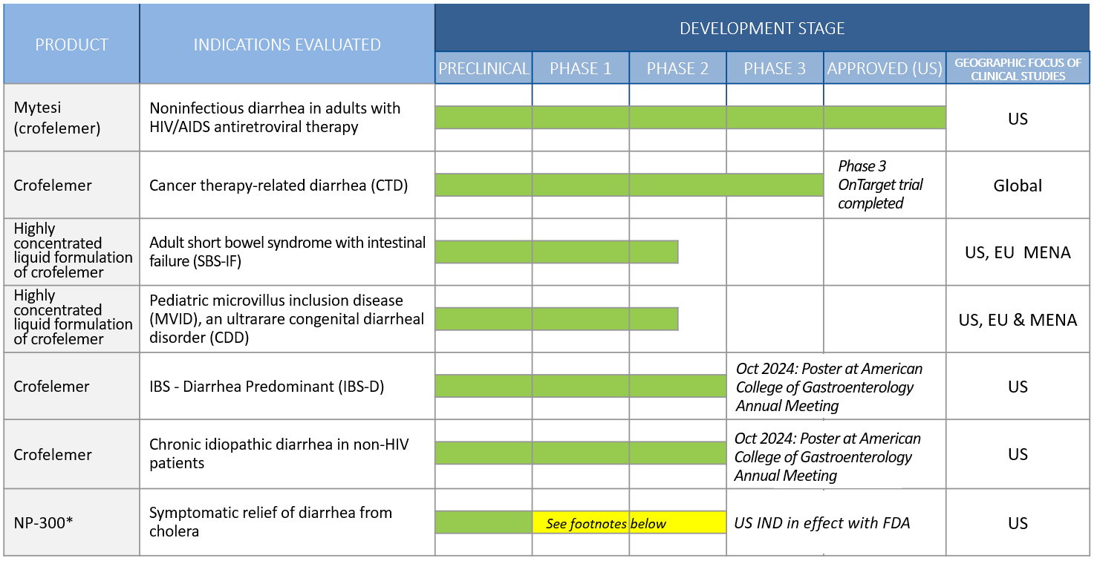
Jaguar/Napo Product Portfolio – Crofelemer Pipeline in a Product
*NP-300 and crofelemer have a similar physiological anti-secretory mechanism of action to reduce chloride ion secretion into the gut lumen and improve stool consistency. The Company has previously presented Phase 2 data on crofelemer for the treatment of devastating dehydration in cholera patients from the renowned International Centre for Diarrhoeal Disease Research (icddr,b) in Bangladesh.
*Potential opportunity for Priority Review Voucher (PRV)
NASDAQ:JAGX

Slide 5

Robustness: Financially, Clinically, Commercially
Financial Robustness: Net Q3 2024 revenue increased 14% versus net Q2 2024 revenue
Clinical Robustness/Near-Term Catalysts:
  Crofelemer in development for multiple possible follow-on indications:
    Five rare/orphan disease indication clinical catalysts in Q4 2024/Q1 2025: SBS-IF and MVID
    Phase 3 data with statistically significant improvement in prespecified subgroup of adult patients with breast cancer
  Two investigator-initiated responder analysis trials of crofelemer show significant results in IBS-D; Data presented at October 2024 American College of Gastroenterology Annual Meeting
  Proprietary anti-secretory antidiarrheal drug for cholera-related diarrhea (potential opportunity for FDA tropical disease priority review voucher) – IND approve
  Jaguar JV Magdalena Biosciences opportunity to file IND for 3 psychoactive botanical drug candidates in 2025
Commercial Robustness: October 2024 commercial launch of the FDA-approved oral mucositis prescription product Gelclair in U.S.
5
NASDAQ:JAGX

Slide 6

Oct 1, 2024: Jaguar Reports Statistically Significant Improvement in Breast Cancer Patients in OnTarget
Crofelemer achieved statistical significance in prespecified subgroup of adult patients with breast cancer from OnTarget. Results in breast cancer patients accepted for poster presentation at December 2024 San Antonio Breast Cancer Symposium (SABCS).
  Data presented at SABCS will serve as cornerstone of briefing package Napo plans to submit to FDA to request meeting to discuss possible pathways to make crofelemer available as efficiently as possible to breast cancer patients.
  Full study report on breast cancer subgroup analysis expected to be submitted to peer-reviewed journal by study’s primary investigators.
Breast cancer patients accounted for majority of OnTarget participants.
OnTarget breast cancer results are a responder analysis, as was the primary endpoint in phase 3 ADVENT trial that led to FDA approval of crofelemer for currently commercialized indication of HIV-related diarrhea.
Additional analyses of OnTarget ongoing, and data from additional analyses is expected to also qualify for submission to peer-reviewed forums.
6
NASDAQ:JAGX

Slide 7
Increasing Market Value: Progression from Supportive Care to Impact on Outcome/Cost of Care to Treatment Modifying
Indication | # of Competitors | Market Size/Potential
HIV-related diarrhea | 0 | Jaguar estimates the U.S. market revenue potential for Mytesi® to be ~$50 million in gross annual sales
Cancer therapy-related diarrhea (CTD) | 0 | Projected to be 2.0 million new cancer cases in US in 2024² >1 million cancer patients receive chemo or radiation in a US outpatient clinic annually³ Comparable supportive care (CINV) global market projected to reach $4.3 billion by 2031⁴
Short bowel syndrome (SBS) with intestinal failure / Microvillus inclusion disease (MVID), a congenital diarrheal disorder (CDD) | 0 | ~10,000 to 20,000 people in US have SBS and approximately the same number in Europe. Orphan-drug designation supports potential accelerated approval. Estimated annual US revenue for Takeda’s SBS drug Gattex: ~$555 million. Global SBS market projected to reach $4.6 billion by 2027 with a CAGR of 26% from 2020 to 2027⁵ (doesn’t include potential contribution from crofelemer’s novel mechanism of action)
IBS - diarrhea predominant (IBS-D) | 3 | ~15% of adult population Most IBS products have estimated revenue potential >$1.0 billion⁶
Symptomatic relief and treatment of diarrhea from cholera and other pathogens | 0 | *Potential opportunity for Priority Review Voucher (PRV) PRVs are transferable, and in past transactions by other companies have sold for values ranging from $67 million to $350 million⁷
¹ Research and Markets 2017 report: "Global Gastrointestinal agents Market Size, Market Share, Application Analysis, Regional Outlook, Growth Trends, Key Players, Competitive Strategies and Forecasts, 2017 to 2025“
² American Cancer Society. Cancer Facts & Figures 2024. Atlanta: American Cancer Society; 2024
³ https://www.cdc.gov/cancer/preventinfections/providers.htm#print
⁴ https://www.ihealthcareanalyst.com/global-chemotherapy-induced-nausea-vomiting-drugs-market/
⁵ https://www.mynewsdesk.com/us/medical-technology-news/pressreleases/short-bowel-syndrome-market-global-industry-analysis-size-share-trends-revenue-forecast-2020-to-2027-3069433
⁶ http://247wallst.com/healthcare-business/2015/04/27/key-analyst-sees-nearly-30-upside-in-ironwood & https://www.benzinga.com/analyst-ratings/analyst-color/17/03/9224181/analyst-synergy-pharma-could-achieve-sustainable-profita
⁷ https://www.raps.org/regulatory-focus/news-articles/2017/12/regulatory-explainer-everything-you-need-to-know-about-fdas-priority-review-vouchers
7
NASDAQ:JAGX

Slide 8




How Crofelemer Works
Crofelemer is a non-opioid that works differently from other treatments for GI dysfunction
With crofelemer, it’s about waterflow
Crofelemer normalizes waterflow in the GI tract
Less water flowing into your GI tract = less watery diarrhea = greater nutrient absorption opportunity
Secretion
Absorption
Crofelemer acts locally in the GI tract
Opioid medicines (i.e., Imodium, loperamide) work by slowing down your GI tract, i.e., opioid constipation risk
Crofelemer is a non-opioid, non-antibiotic, non-addictive drug approved in the US for a chronic use
8
NASDAQ:JAGX

Slide 9
Our crofelemer clinical development programs
9
NASDAQ:JAGX

Slide 10


July 23, 2024: Jaguar Reported Phase 3 OnTarget Trial Results for its Cancer Supportive Care Drug Crofelemer
  A growing and urgent unmet medical need exists for novel non-opioid chronic agents to treat CTD.
  Unprecedented trial included patients with 10 different tumor types and 24 different targeted agents, with and without multiple standard cytotoxic chemotherapies.
  Study did not meet prespecified analysis of primary endpoint for all tumor types.
  Clinically meaningful signals breast and lung cancers are two of the three most common cancers, with patients often remaining on targeted therapy over prolonged periods.
  Phase 3 data with significant results in prespecified subgroup of adult patients with breast cancer
    Patients with CTD 40% more likely to discontinue chemotherapy or targeted therapy than those without CTD¹
    The cost of care of CTD patients is estimated to be 2.9 times higher than for patients who are not experiencing CTD²
  Company expects to engage with FDA after full review of data, expected Q3 2025
¹ Pablo C. Okhuysen, M.D. Impact of Cancer-Related Diarrhea on Changes in Cancer Therapy Patterns: Real World Evidence
² Eric Roeland, M.D., FAAHPM. Healthcare Utilization and Costs Associated with Cancer-Related Diarrhea
10
NASDAQ:JAGX

Slide 11

Importance of the Patient Voice in Managing Cancer Care Effectively
Paradigm shifting treatment with crofelemer
Strength of that voice as patients continue targeted therapies for months and years rising, important, and playing a role in what type of cancer treatment fits with the goals and the life of the patient (QoL)
Patient dignity and comfort paramount
Cancer patients = everyday people—parents, children, at school, in the workforce
11
NASDAQ:JAGX

Slide 12

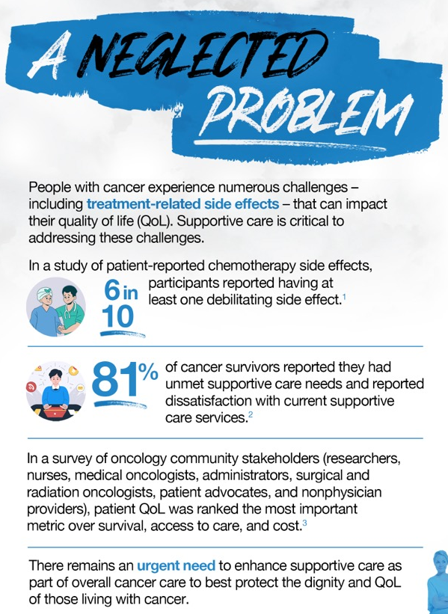
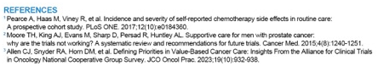
Napo Pharmaceuticals’ Make Cancer Less Shitty Patient Engagement Program
12
NASDAQ:JAGX

Slide 13
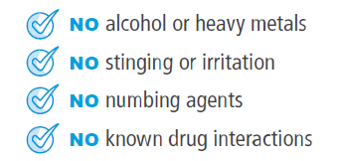


October 2024 Commercial Launch of Gelclair—Jaguar’s 3rd Commercialized Prescription Product
Oral mucositis is defined as the most significant adverse event in oncology according to a National Comprehensive Cancer Network task force
  Gelclair is an FDA-approved mucoprotective gel that coats the surface of the mouth to provide long-lasting relief
Who suffers from oral mucositis?
  90% incidence in head and neck radiation¹ and bone marrow transplant
  30-75% of all patients receiving chemotherapy
Oral mucositis is a dose-limiting side effect of cancer treatment
  19% of patients with head and neck cancer who develop oral mucositis may end up being hospitalized,¹ which can involve interruption of cancer treatment
¹ Pulito C, Cristaudo A, Porta C, Zapperi S, Blandino G, Morrone A, Strano S. Oral mucositis: the hidden side of cancer therapy. J Exp Clin Cancer Res. 2020 Oct 7;39(1):210. doi: 10.1186/s13046-020-01715-7. PMID: 33028357; PMCID: PMC7542970.
13
NASDAQ:JAGX

Slide 14
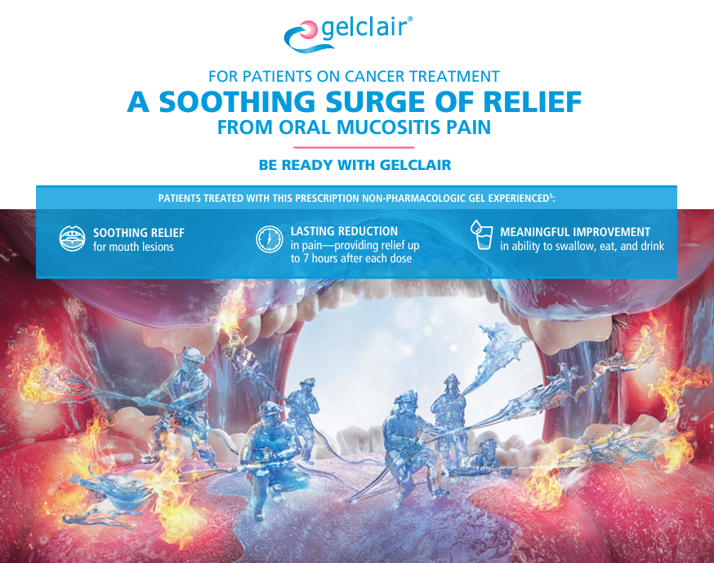
Ongoing Gelclair Campaign
14
NASDAQ:JAGX

Slide 15

US Oral Mucositis Market Size and Opportunity
Oral mucositis often leads to dose reductions or interruptions in cancer therapy, which can adversely affect overall treatment outcomes.
Hospitalizations for pain management, nutritional support, and treatment modifications can lead to additional healthcare costs ranging from $17,000 to $42,000 per patient over the course of treatment.
  Significant downstream costs
The global market for oral mucositis treatments is projected to reach approximately $2.4 billion by 2027, with North America being the largest market
Net revenue for Mytesi in 2023 was $9.6 million. To match Mytesi 2023 sales, we would need about 3,500 Gelclair patients to be on the product for 30 days each in 2024. This represents about 3.8% of the addressable US market.
15
NASDAQ:JAGX

Slide 16



Canalevia®-CA1 (Crofelemer): A New Standard of Care For Treatment of Chemotherapy-induced Diarrhea (CID) in Dogs Launched April 2022
Canalevia-CA1 received conditional approval in December 2021—the first and only product indicated for CID in dogs to receive any type of approval from FDA
Approximately 1 in 4 dogs will, at some stage in their life, develop neoplasia. Almost half of dogs over the age of 10 will develop cancer. ~6 million new cancer diagnoses are made in dogs each year in the U.S.
Pet owners’ willingness to pay for life saving treatments and procedures increases with patient comfort.
For the most part, dogs receive human chemotherapeutic agents during treatment and suffer the same side effects as humans, which means ~40% of treated dogs may have their chemotherapy reduced, changed, or discontinued due to diarrhea—which can compromise the full benefit of the chemotherapy agent.
Similar dynamics to human specialty market, but with greater correlation between gross and net revenue with pet owner paying out of pocket.
Conditional approval in dogs is similar to orphan drug designation in humans.
https://www.avma.org/resources/pet-owners/petcare/cancer-pets
16
NASDAQ:JAGX

Slide 17
Jaguar Health’s Strategic Focus on Rare Diseases
Rare diseases, when taken together, are not that rare at all
30 million Americans¹, or 10 percent of the population, have one of the approximately 7,000 known rare diseases²
An estimated 30 to 40 million people in the EU³ and 400 million worldwide⁴ have a rare disease
Definition of a rare or orphan disease by region:
US: When a disease affects <200,000 people⁵
EU: When a disease affects <1 in 2,000 people⁶
  EU: “Ultra-rare disease”: When a disease affects no more than 1 in 50,000 people⁷
Reimbursement coverage is often available due the rare disease’s high morbidity and mortality rates, and as a result of support from patient activist groups
SHORT BOWEL SYNDROME WITH INTESTINAL FAILURE
MICROVILLUS INCLUSION DISEASE (A congenital diarrheal disorder)
DIARRHEA FROM CHOLERA
(Designated as rare disease in US)
^{1 & 2} Source: https://phrma.org/Scientific-Innovation/Progress-in-Fighting-Rare-Diseases
³ Source: Harari S. Why We Should Care About Ultra-Rare Disease. Eur Respir Rev. 2016 Jun;25(140):101-3. doi: 10.1183/16000617.0017-2016
⁴ Source: https://rarediseases.org/rare-disease-day-2022-advancing-the-conversation-around-health-equity/
⁵ Source: https://www.fda.gov/patients/rare-diseases-fda#
⁶ Source: https://www.eurordis.org/information-support/what-is-a-rare-disease/
⁷ Source: European Commission Regulation (EU) No.536/2014 of the European
Parliament and of the Council of April 16, 2014 on clinical trials on medicinal products for human use, and repealing Directive 2001/20/EC. 2014. Available from: http://eur-lex.europa.eu/legal-content/EN/TXT/PDF/?uri=CELEX:32014R0536&qid=1421232837997&from=EN
Orphan Drug Designation: SBS and MVID, US and EU
17
NASDAQ:JAGX

Slide 18
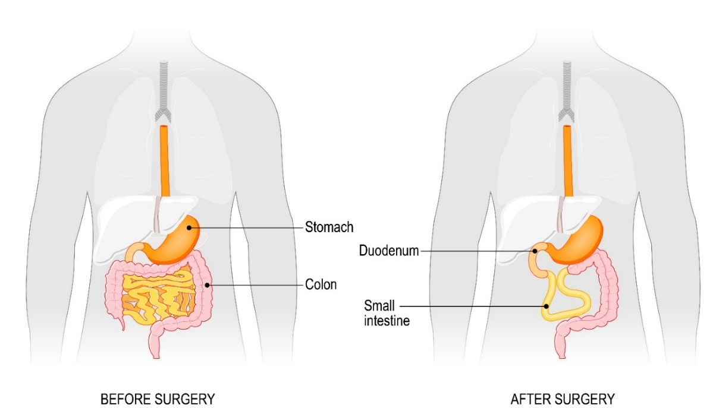
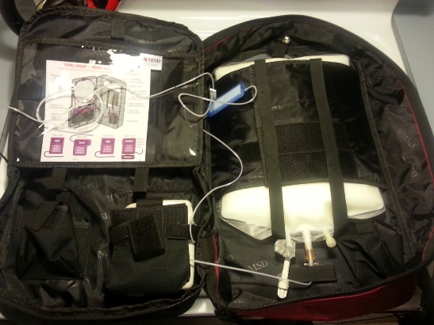
Short Bowel Syndrome – Loss of Bowel with Quality-of-Life Changes
  SBS: Catastrophic loss of bowel often due to surgical resection of diseased or necrotic bowel (normal 15-25 feet to 5 or less feet) in adults/children (also may be congenital in children).
  SBS with Intestinal Failure (SBS-IF): A condition in which your body is unable to absorb enough nutrients from the foods you eat because you do not have enough small intestine. Patients suffer from malnutrition, dehydration, imbalances of fluids and salts, excessive intestinal fluid output, and risk of organ failure.
    Life-long parenteral nutrition (PN) may be required
    No “standard of care” drug intervention
Parenteral nutrition backpack for patients with intestinal failure
18
NASDAQ:JAGX

Slide 19

A Global Opportunity
  SBS Patient Population​​:
    ~10,000 to 20,000 in US
    ~10,000 to 20,000 in Europe
  Despite limited treatment options, the global SBS market exceeded
  $568 million in 2019 and is expected to reach $4.6 billion by 2027¹
  Gattex (teduglutide; growth hormone):
    Estimated share of US market: ~1-2%³
    Annual cost in US: ~$485,400⁴
    Multiple biosimilars in development by other companies
    “Gattex can make abnormal cells that are already in your body grow faster. There is an increased risk that abnormal cells could become cancer.”
  Non-hospitalized parenteral nutrition in the US is approximately $150,000 per year⁵
  Frequent hospitalizations for infections
¹ https://www.mynewsdesk.com/us/medical-technology-news/pressreleases/short-bowel-syndrome-market-global-industry-analysis-size-share-trends-revenue-forecast-2020-to-2027-3069433
² Jaguar estimate based on projected Gattex 2020 revenue of 554.9M USD (based on Takeda financial reports) divided by annual per-patient expenditure for Gattex of $376.2K in 2016 (figure sourced from https://www.ahip.org/documents/HighPriceDrugsReport.pdf)
³ Jaguar estimate based on an estimated US SBS population of 10,000-20,000 people (www.crohnscolitisfoundation.org/sites/default/files/legacy/assets/pdfs/short-bowel-disease-crohns.pdf)
⁴ 10 priciest drugs in America (https://www.benefitspro.com/2020/08/24/10-priciest-drugs-in-america/?slreturn=20221021163553)
⁵ https://nutritionequity.org/wp-content/uploads/2018/05/mnea-factsheet-sbs.pdf
19
NASDAQ:JAGX

Slide 20
Proposed Treatment Pathway: Crofelemer May Reduce Need for Parenteral Nutrition in SBS-IF Patients
Crofelemer
Nutritional support (delivery of nutrients, electrolytes and fluids):
Intravenous nutrition or home parenteral nutrition
Enteral feeding tube (used infrequently)
Teduglutide
Given concomitantly with nutritional support
If warranted
Daily subcutaneous injection into abdomen, thigh, or arm; different injection site each time
Surgery to reconstruct or lengthen the remaining parts of the bowel
Intestinal transplant
(in case of progression)
    Reduction of parenteral nutrition would lead to improvement of patients’ quality of life
20
NASDAQ:JAGX

Slide 21
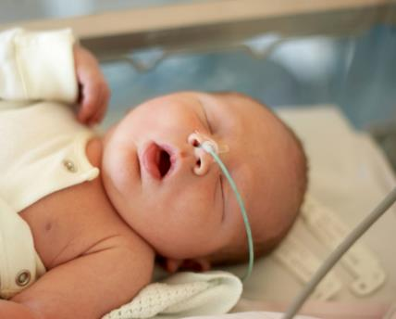
Microvillus Inclusion Disease (MVID): An Ultra Rare CDD
MVID is an ultra rare congenital diarrheal disorder (CDD) that affects newborns and children and leads to significant morbidity and mortality from severe secretory diarrhea, intestinal failure
Key Milestones:
Investigational New Drug (IND) application for crofelemer for MVID activated by FDA in August 2023
Single digit number of patients treated to receive approval?
* Adverse events could negatively affect the timeliness of submitting the Investigational New Drug (IND) application. There is a probability that the FDA may not approve Company’s IND application.
21
NASDAQ:JAGX

Slide 22

NP-300 Drug Candidate for the Symptomatic Relief of Diarrhea from Cholera and Other Pathogens
Cholera is designated as a rare disease in the United States, where nearly all reported cases are acquired during international travel
Our NP-300 Drug Candidate:
  Second-generation anti-secretory drug
  Same source plant as crofelemer
Clinical proof-of-concept for the CFTR ion channel MOA of NP-300 demonstrated by crofelemer for the reduction of diarrhea-associated dehydration in cholera patients: International Centre for Diarrhoeal Disease Research (icddr,b) in Bangladesh
IND activated
Plan to pursue Priority Review Voucher (PRV) (in past transactions by other companies PRVs have sold for values ranging from $67M - $350M)
22
NASDAQ:JAGX

Slide 23


Jaguar and Filament Health, with Funding from One Small Planet, Form Joint Venture Magdalena Biosciences to Develop Botanical Pharmaceutical Drug Candidates for Mental Health Illnesses
Magdalena currently valued at US$5.0 million based on initial funding of US$1.0 million from One Small Planet
Magdalena Biosciences leverages Jaguar’s proprietary 2300 medicinal plant library
Jaguar currently owns ~40% of Magdalena
Goal of Collaboration: To extend the botanical drug development capabilities of Jaguar to:
  Develop pharmaceutical-grade, standardized drug candidates for mental health disorders including attention-deficit/hyperactivity disorder (ADHD) in adults
  Partner with a potential future licensee to develop and commercialize these novel plant-based drugs
Three IND ready candidates (ADHD, schizophrenia, anxiety). Non dilutive financing
23
NASDAQ:JAGX

Slide 24
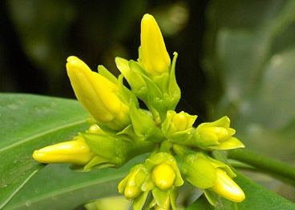
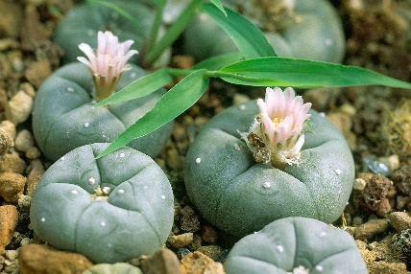
Magdalena Biosciences
Program to support the discovery and development of novel psychoactive medicines derived from plants for mental health and CNS disorders
    Leverage Company’s proprietary library of ~2,300 plants and ~3,500 plant extracts with ethnomedicinal investigation
    Seeking next generation first-in-class agents, novel mechanisms of action, disease modifying agents
Eight key agents being pursued by psychedelic-focused companies:
LSD and derivatives
Psilocybin and derivatives (mushrooms in the genus Psilocybe)
Iboga and derivatives
Toad sections from Bufus Alvarius 5-MeO-DMT
MDMA (referred to as ecstasy or Molly)
Ketamine
Mescaline and derivatives (peyote is most well-known source but not only source)
DMT and derivatives (most well-known source is the Banisteriopisis and Psychotria viridis mixture known as Ayahuasca)
Picralima nitida plant, the source of the active ingredient alstonine
Peyote (Lophophora williamsii), a source of mescaline
Picralima nitida image copyrighted by Hiobson and licensed under the Creative Commons Attribution-Share Alike 4.0 International license
24
NASDAQ:JAGX

Slide 25
Net Revenue: Q3 2024 net revenue increased approximately 14% versus net Q2 2024 revenue
25
NASDAQ:JAGX

Slide 26





Expected Upcoming Catalysts – Financial, Clinical & Commercial
  Ongoing: Commercial launch (began Oct 2024) of FDA-approved Gelclair product for oral mucositis
  Ongoing: Poster presentations at Dec 2024 San Antonio Breast Cancer Symposium.
  Dec 2024/Jan. 2025: Initiation of crofelemer IIT in Abu Dhabi in pediatric patients with SBS-IF or MVID
  Dec 2024: Initiation of crofelemer IIT at Cleveland Clinic in adult SBS-IF patients
  Dec 2024: Initiation by Napo Pharmaceuticals of global Phase 2 study of crofelemer for MVID
  Jan 2025: Initiation by Napo Therapeutics of global Phase 2 study of crofelemer in adult SBS-IF patients
  Q1 2025: Initiation of two additional crofelemer IITs for SBS-IF and MVID
  Q2 2025: Initial proof-of-concept (POC) data available for crofelemer for SBS-IF and MVID in support of potential early patient access in specific EU countries
  Q2 2025: Briefing package submitted to FDA on OnTarget results in breast cancer patients for CTD
  Q2 2025: Business development deal for development and commercialization of company’s NP300 prescription drug candidate for general in dogs
  Q3 2025: Meeting with FDA to obtain clarity regarding possible pathways to make crofelemer available as efficiently as possible to breast cancer patients for CTD
  2025: Jaguar mental health-focused joint venture Magdalena Biosciences to initiate clinical development for botanical drug candidate
  1H 2026: End of Phase 2 trials of crofelemer in SBS-IF and MVID
* Key milestones are based on management estimates. Adverse events could negatively affect their business and the timeliness of achieving key milestones.
26
NASDAQ:JAGX

Slide 27
Jaguar/Napo Pharmaceuticals Executive Management Team
Name / Title | Experience
Lisa Conte Founder & CEO | 30+ years of industry experience Obtained first anti-secretory human product FDA approval Board of Directors of Healing Forest Conservancy Raised over $400 mm
Carol Lizak, MBA Chief Financial Officer | 20 years corporate controllership and financial planning and analysis experience under U.S. GAAP & IFRS 10+ years with public companies including foreign subs (5 years in biopharma)
Steven King, PhD Chief Sustainable Supply, Ethnobotanical Research & IP Officer | Served as head of sustainable supply, ethnobotanical research & IP: 1989-2020 Board of Directors of Healing Forest Conservancy
Pravin Chaturvedi, PhD Chief Scientific Officer Chair of Scientific Advisory Board | 25+ years drug development experience Co-Founded Scion, IndUS and Oceanyx Pharmaceuticals Successfully developed Mytesi® (first pivotal adaptive design) and 7 pharmaceutical products
Karen J. Brunke, PhD Executive VP, Corporate & Business Development | 30+ years experience in research, operations and BD in pharma/biotech Primary responsibility in deals with MedImmune, Astellas; closed GSK deal Successfully developed GMOs at Sandoz while Research Director
Darlene Horton, M.D. Chief Medical Officer | Biopharmaceutical veteran and leading clinical development expert 25 years experience in development of investigational and commercialized biopharmaceutical and drug-device combination products; experienced in design of SBS clinical programs
David Sesin, PhD Chief Manufacturing Officer | Pharmaceutical scientist with experience from drug discovery through manufacturing Developed crofelemer manufacturing process
Jonathan Wolin, JD, MBA Chief of Staff, Chief Compliance Officer & General Counsel | Extensive experience providing legal advice and guidance to public and private companies in the healthcare and biotechnology industries
Ian H. Wendt, MBA Chief Commercial Officer | Has held commercial leadership roles across sales, marketing and operations at some of the largest brands in the pharmaceutical industry over past 25 years
Allison A. Shrier, M.D. Napo Pharmaceuticals VP, Clinical Research & Medical Affairs | Physician-scientist-entrepreneur with expertise in oncology & metabolism Expertise in end-to-end drug discovery & development including population identification, target product profiles development, hit design, selection & optimization, preclinical & clinical study planning
27
NASDAQ:JAGX

Slide 28
Investment Highlights
Mytesi (Crofelemer): FDA-Approved Human Drug
  Only FDA-approved diarrhea treatment that’s been studied specifically in adults with HIV / AIDS
  Supply chain in place
Planned Crofelemer Expansion
  Progression from supportive care to impact on outcome/cost of care to treatment modifying
  Napo’s CTD - Phase 3 OnTarget study: Company to complete analysis of full data for first and second 12-week periods of trial in support of FDA discussion
  SBS with intestinal failure - treatment modifying
  3 IITs (functional diarrhea, IBS, IBD)
Strategic Focus on Rare Diseases
  SBS with intestinal failure
  Initial CDD target indication: microvillus inclusion disease (MVID)
  Other rare diseases, real world PRO
Canalevia-CA1 for chemotherapy-induced diarrhea (CID) in dogs
  Canalevia-CA1 FDA conditionally approved December 2021
  Estimated 6 million new cancer diagnoses in dogs each year in US; 25-40% experience diarrhea
  Management of CID in dogs is a comfort issue for dogs and may also help dogs better tolerate chemo and improve the home/living environment for owners
Strategic Partnerships
  Unencumbered global commercial rights to Mytesi/crofelemer pipeline
  License deals completed in Europe, Canada, Middle East; ongoing discussions for Asia, LATAM
  Magdalena Biosciences leveraging proprietary 2,300-plant ethnobotanical database
Strong Management Team
  Key management has been with the team for >20 years
  Chairman of board and key investors have invested for >30 years
Proprietary Position
  ~192 patents (majority do not expire until 2027 - 2031) and ~42 patents pending
  Sustainable supply of commercial scale of raw material sourcing
  Botanical guidance protection – no practical generic pathway
28
NASDAQ:JAGX

Slide 29
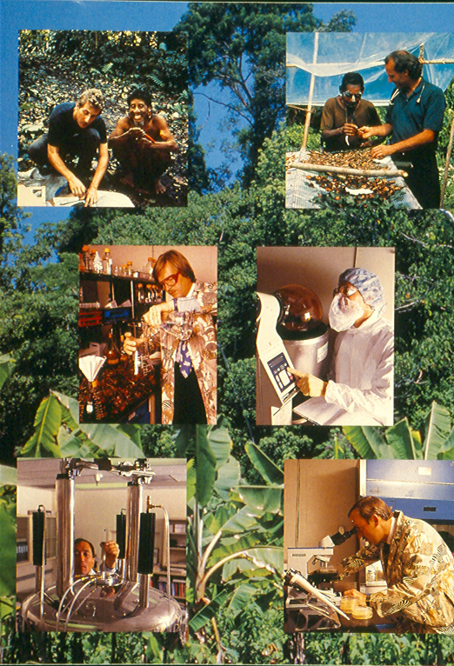
Jaguar Health, Inc. (NASDAQ: JAGX)
Contact:
hello@jaguar.health

